Slide 1
DEVELOPING Critical ThinkERS & the Practice of inclusionary Leadership
Stephen Brookfield
University of St. Thomas
Minneapolis-St. Paul
www.stephenbrookfield.com

Slide 2
STEAL FROM MY HOME PAGE!!
My home page is open access so if you want to find out more about any of the exercises or activities I mention go to the page and click on the ‘Resources’ link.
There you will find multiple PDF files of workshop packets stuffed with activities or power point files.
You do not need to ask my permission to use any of these resources. If they’re useful then please try them out and adapt them to your context.
www.stephenbrookfield.com

Slide 3
Thinking critically is a core leadership Skill first we need to hunt our assumptions
Our actions, decisions & choices as leaders are based on ASSUMPTIONS
Assumptions are the causal links, guidelines & axioms that undergird action
These assumptions need to be unearthed & appraised; to what extent do they fit the situation we’re dealing with?
Assumptions are rarely completely true or completely false; rather, they’re more or less valid & accurate depending on context & circumstance

Slide 4
And then we need to See Things from Multiple Perspectives
We try to see our decisions, actions & practices from multiple viewpoints & in multiple contexts
We engage in perspective taking: seeing things as others see them – how does this look from your POV?
We constantly open ourselves to new experiences & seek out new information to challenge ourselves
We practice self-criticism

Slide 5
INFORMED ACTIONS ARE…
Based on Assessed Evidence or Experience
Have their Assumptions Known & Checked
Stand a Good Chance of Achieving Their Intended Consequences
Can Be Clearly Explained to an Interested 3rd Party

Slide 6
Core processes of critical thinking
Hunting
Hunting the Assumptions Informing Leadership Decisions, Judgments & Actions
Exploring
Exploring Multiple Perspectives on Our Practice of Leadership

Slide 7
A Personal Example
When suffering from clinical depression for several years, why did I not seek help?
Assumptions:
Clinical Depression is Caused by External Circumstances
The Way to Deal With It Is To Reason Through It & Tell Yourself To Snap Out of It
Medications Are For Those Too Weak To Survive
Only Women Seek Help

Slide 8
Why Did I Not Seek Help?
Ideology of Patriarchy - because of innate superior intelligence, ability to use reason & logic, & capacity for calm, objective analysis, men should be entrusted with the power & control to make decisions. Women are deemed to be too unsophisticated, irrational & emotional to be entrusted with power. Women are portrayed as having compassion & empathy but they can’t be trusted to think clearly, objectively and rationally in a crisis.
My internalization of patriarchy meant I felt shame at my ‘irrational’ depression & my failure to reason my way out of it. I felt medication was only for the weak (i.e. women)

Slide 9
Reframed Assumptions
Depression is a chemical imbalance in the brain – not a flaw in character
Talk & cognitive behavior therapy is helpful and medication is crucial for brain chemistry
Patriarchy damages men by denying their emotionality & inducing false shame
My responsibility is to make appropriate public disclosure of my own depression

Slide 10
A professional example
If I get to a meeting early & arrange the chairs in a circle…
Colleagues will feel their experience is respected & acknowledged when they walk in.
This will create a relaxed and congenial environment for sharing openly
The distance between me as the leader & them as my reports to will be reduced
People will be more likely to participate, contribute, ask questions etc.

Slide 11
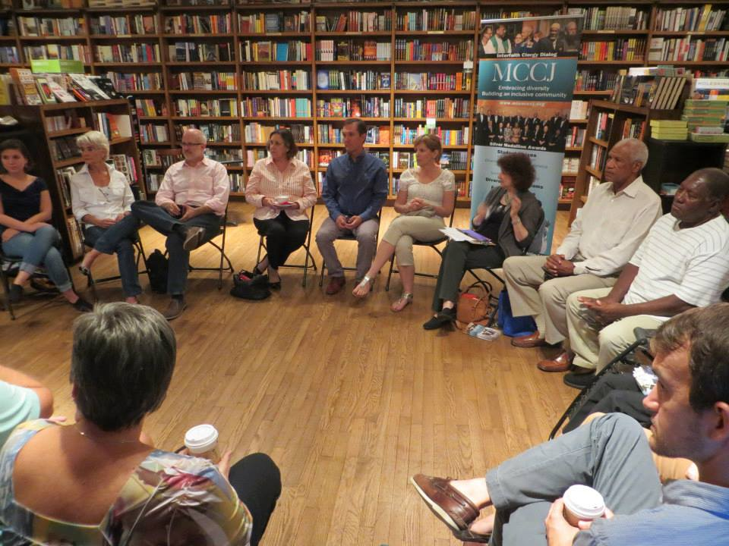

Slide 12
Perceptions of the Circle
The circle is an arena of surveillance – everything I do is seen, my mistakes are noticed by everyone
The circle is alienating – if anything about me marks me out as different (how I look or sound) my discomfort is increased
The circle is coercion – you are coercing me into speech before you have earned the right to do that
The circle increases mistrust – I can’t sit back & judge your competence or authenticity over time

Slide 13
Now I still use the circle but explain…
It’s to keep sight lines clear – so people who wish to contribute or ask a question can do that easily
People don’t have to talk to the back of others’ heads
I won’t assume that those who are quiet are less diligent, uncommitted or unintelligent
I must self-disclose regarding my experiences before expecting people to do the same
I must be the first to take the risk to think critically about my own practice

Slide 14
A racial example – The ‘good’ white

Slide 15
I am a GOOD WHITE PERSON who doesn’t see color or race – my assumptions
I can monitor my own racism
I know how my actions are perceived & experienced
I am free of racial micro-aggressions
Racism is committed by less-enlightened white friends & colleagues
I am a trusted ally on the right side of history

Slide 16
In reality
I regularly commit racial micro-aggressions – eye contact, examples I use, how I run meetings & classes, jokes with other Whites
I will never be free of the learned ideology of White Supremacy
I cannot expect my assurances of anti-racism to be believed
I will be best positioned to uncover my racism by working in multi-racial teams
I should never declare myself an ally
S.D. Brookfield Teaching Race. San Francisco: Jossey/Bass-Wiley, 2019

Slide 17
The critical practice of INCLUSIONARY leadership
Adjust your definition of success – having the conversation & keeping it going
Frame the need for conversation in terms of the mission, purpose, strategic plan
Talk publicly about your own learned racism & how you struggle to combat it
Define racism as structural, systemic, all pervasive, - a virus, learned behavior, air we breathe
Provide videos & first hand testimony of how racism is experienced

Slide 18
The critical practice of INCLUSIONARY leadership
Set
Ground rules – brave space, challenge behavior not the person, only questions, expecting emotional expression, expecting anger
Build
Community responsibility for conversation – regular reflections on dynamics, tensions, ambiguity
Use
Specific protocols – Bohmian dialog, methodological belief, circle of voices, circular response, snowballing
Create
Create anonymous backchannels – backchannel chat, sli.do, Critical Incident Questionnaire

Slide 19
The critical practice of INCLUSIONARY leadership
Explain your process as facilitator / leader; how you apply fairness, why you stay with a particular person/issue, why you call on people, stand your ground when people try to resist & deflect
Start with events & scenarios away from people’s direct experience & then slowly move to a direct examination of personal/group/organizational events
Increase complexity by moving from unequivocal glaring examples of racism to more nuanced examinations involving intent, context, micro-factors
Share regular, public formative evaluation shared with the community

Slide 20
Building criticality into leadership
www.backchannelchat.com
For ‘display name’ - use only numbers
For ‘code’ enter - q3ba2

Slide 21
Respond to this question…
When you’ve seen inclusionary leadership in action, what does it look like to you?

Slide 22
Circle of Voices
Individuals reflect silently & individually on the agenda item, issue or question (1-2 minutes).
Participants go round the circle in order - each person has up to 1 minute of uninterrupted air time to give their viewpoint on the topic. No interruptions are allowed
People move into free discussion with the ground rule that every comment offered must refer back to a comment made by someone else in the opening circle of voices.

Slide 23
question
How do you, or how could you, model inclusionary leadership?

Slide 24
WHITE Leaders’ COMMON mistakes around inclusion
Blaming
People for the Workings of a System They Can’t See Clearly
Shaming
People for Being White
Denigrating & Disdaining
People for not Having Racial Awareness
Preaching
From Position of Superiority – You are Woke
Requiring
Confession to Racial Sins
Withholding
White voices in multiracial dialogues
Expecting
Appreciation & Reward – ‘Good White Medal’
Declaring
Yourself an Ally – Not your Judgment to Make

Slide 25
C
www.stephenbrookfield.com
Creating an Anti-Racist White Identity (2020) Stephen Brookfield & Mary Hess (Stylus) Forthcoming.
Teaching Race (2019) Stephen Brookfield (Wiley)
The Discussion Book: 50 Great Ways to Get People Talking (2016) Stephen Brookfield & Steve Preskill (Wiley)
Learning as a Way of Leading (2008) Steve Preskill & StephenBrookfield (Wiley)

