Slide 1
TEACHING FOR CRITICAL THINKING Florida Gulf Coast University
Stephen Brookfield
University of St. Thomas
(Minneapolis-St. Paul, USA)
www.stephenbrookfield.com

Slide 2
HOME PAGE - www.stephenbrookfield.com/
My home page is open access so if you want to find out more about any of the exercises or activities I mention go to the page and click on the ‘Resources’ link.
Scroll down & you will find multiple PDF files of workshop packets stuffed with activities or power point files.
You do not need to ask my permission to use any of these resources. If they’re useful then please try them out and adapt them to your context.
http://www.stephenbrookfield.com/

Slide 3
Introducing Myself
History of academic mediocrity – failed my college track exams, my university entrance exams, graduated well in the bottom half of my class, failed my master’s degree exam – Broadening student-centered assessment measures
Watching my doctoral supervisor – giving me ‘bad’ inconvenient news in a way that I knew was in my own best interests
Ethical use of teacher power
Relational underpinnings to teaching

Slide 4
www.todaysmeet.com/crit
Please go to: www.todaysmeet.com/crit
Sign in by creating a nickname for yourself (random numbers, sports team, birthdate etc.) DON’T USE YOUR REAL NAME!
Please post a greeting so we know the system is working

Slide 5
How Today’s Meet Helps Teach Critical Thinking
Create a new page for each class session you teach
Tell students you’ll leave it on throughout the class so they can post reactions, comments, questions etc. as they arise
As the session proceeds you’ll see different responses, reactions & questions that illustrate the different perspectives people have on new information, theories or analytical frameworks
You can also use Today’s Meet to generate immediate multiple perspectives by posing a question to the whole class & asking them to respond via the tool. In a few seconds a diversity of responses will appear illustrating the multiple viewpoints possible.

Slide 6
WWW.TODAYSMEET.COM/CRIT
HOW DO YOU EXPLAIN OR DEFINE CRITICAL THINKING FOR YOUR STUDENTS?
Take a minute to share your answer with someone next to you and then post a response to this question on www.todaysmeet.com/crit

Slide 7
Most Faculty Agree that….
Every Student Should Know the Grammar of their Subject or Discipline – To be Able to Think like an Engineer, Historian, Biologist, Psychologist, etc.
Content Grammar: Foundational information, core knowledge, building block concepts, most important theories, major schools of thought, and so on
Epistemological Grammar: The process by which we establish the known truth within a discipline – this is what the critical thinking part of higher education focuses on

Slide 8
Students Demonstrate Epistemological Grammar When They….
Provide evidence for their assertions, arguments, statements, hypotheses
Give reasons for considering an argument, theory or statement to be valid and accurate
Demonstrate the ability to build arguments by showing inferential ladders & chains of reasoning
Develop the intellectual flexibility to seek out alternative perspectives and viewpoints
Practice continuous self-appraisal & welcome critique

Slide 9
It’s a Process of APPRAISAL
To what degree do you or others provide evidence for any assertions, arguments, statements, hypotheses?
How valid and accurate are the reasons you or others give for considering an argument, theory or statement to be true?
How clearly do you or others show the steps in reasoning for the arguments that are built?
To what degree do you or others demonstrate the effort to seek out alternative perspectives and viewpoints?
How do you or others practice continuous self-appraisal & show how critique is welcomed & encouraged?

Slide 10
Positioning Critical Thinking for Students
Adult life is a series of micro & macro decisions, choices & judgments
We want these choices & actions to be good ones that work for us
We can help this happen by checking the assumptions that lie behind these decisions
Adulthood begins when you stop universalizing your own experience (Jurgen Habermas) & understand that people see things in different ways

Slide 11
So Critical Thinking Is Firstly
HUNTING & CHECKING ASSUMPTIONS
Our actions, decisions & judgments in life & scholarship are based on ASSUMPTIONS
These assumptions need to be unearthed & appraised – to what extent do they fit the situation, apply to the material, or support our arguments?
Assumptions are rarely completely true or completely false – rather they are more or less valid & accurate depending on context & circumstances

Slide 12
And Critical Thinking is Secondly…
SEEING THINGS FROM MULTIPLE VIEWPOINTS
We try to see our decisions, actions & practices from multiple viewpoints & in multiple contexts
We engage in perspective taking: seeing things as others see them
We constantly open ourselves to new experience & seek out new information
We practice self-criticism being open to the possibility that we have not understood properly

Slide 13
WHY DO STUDENTS FIND CRITICAL THINKING DIFFICULT?
Developmentally 18-22 year olds are at the ‘Formal Operations’ Stage of Intellectual Development
Starting to think abstractly & conceptually
Can begin to formulate hypotheses
Can understand cause & effect
Can apply problem-solving protocols

Slide 14
BUT 18-22 year olds struggle with…
Thinking Dialectically – holding two apparently contradictory ideas in tension; i.e. good leaders are always transparent about the reasons for their actions –v- in some situations the LAST leaders should do is be transparent about their actions
Thinking Contextually - behavior & action can only be fully understood in context (historical, social, intellectual, workplace). Context inevitably changes understanding & application

Slide 15
LET’S GET SPECIFIC – A Personal Example
Assumptions:
Clinical Depression is Caused by External Circumstances
The Way to Deal With It Is To Reason Through It & Tell Yourself To Snap Out of It
Medications Are For Those Too Weak To Survive
Rooted in PATRIARCHY
(Men are to be entrusted with making decisions by virtue of their superior rationality & logic)

Slide 16
Re-Framed Assumptions
FRIENDS, FAMILY, PROFESSIONAL HELP CHALLENGED OLD ASSUMPTIONS. NOW…
Depression is a chemical imbalance in the brain – not a flaw in character
Talk & cognitive behavior therapy is helpful against a background of medication
Patriarchy damages men
My responsibility is to make public disclosure of my own response to my own depression

Slide 17
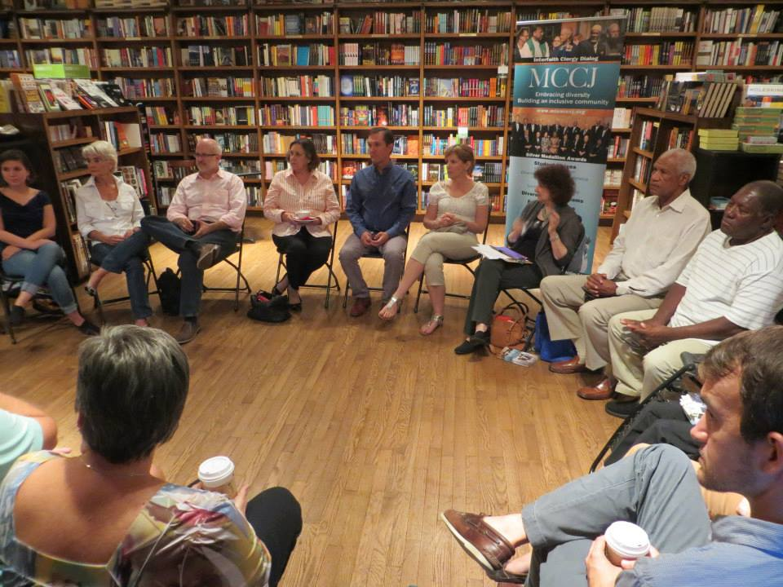

Slide 18
The Circle - Assumptions
If I get to class early & arrange the chairs in a circle…
Students will feel their experience is respected & acknowledged when they walk in.
This will create a relaxed and congenial environment for learning
The distance between me as the teacher & them as the students will be reduced
Students will be more likely to participate, contribute, ask questions etc.

Slide 19
Students’ Perceptions
The circle is an arena of surveillance – everything I do will be seen, my mistakes will be noticed by everyone (peers & instructor)
The circle is alienating – if anything about me marks me out as different (how I look or sound) my discomfort is increased
The circle is coercion – you are coercing me into speech before you have earned the right to do that
The circle increases mistrust – I can’t sit back & judge your competence or authenticity

Slide 20
NOW…
I still use the circle but explain…
It’s to keep sight lines clear – so students who wish to contribute or ask a question can do that easily
It’s so students don’t have to talk to the back of other people’s heads
I won’t assume that those who are quiet are less diligent, uncommitted or unintelligent
I must self-disclose before expecting students to do the same

Slide 21
RACIAL EXAMPLE – Good White Person

Slide 22
The Good White Person
Assumptions…
I have self-knowledge
I don’t see color
I can monitor my own racism
My learned biases can be checked
I know how my actions are perceived & experienced
I am free of racial micro-aggressions
Racism is something committed by less-enlightened White friends & colleagues

Slide 23
From Colleagues, Friends & Reading I Know
I have learned & internalized the ideology of White supremacy & I will never lose that deep conditioning
White supremacy is not the KKK, Aryan Nation, Nazis etc.
White Supremacy is a set of ideas that hold…
Whites should naturally be in positions of power because of their superior intelligence, ability to think rationally & logically – this makes them qualified to decide for all
Eurocentric forms of knowledge production are innately superior & should be used to guide the affairs of all

Slide 24
From Colleagues, Friends & Reading I Know
I regularly commit racial micro-aggressions – eye contact, examples I use, jokes I tell, how I run meetings & classes, biases reinforced with other Whites
Recognizing Micro-Aggressions …
The receiver is left wondering ‘did that happen or am I seeing something that doesn’t really exist – am I being over sensitive?’ ‘Did I just imagine that?’
When pointed out Whites immediately deny any overt intent & believe it’s all a mistake

Slide 25
So what do students say helps them think critically?
WHEN IT’S MODELLED EXPLICITLY & PUBLICLY BY TEACHERS
WHEN ACTIVITIES ARE SEQUENCED SO STUDENTS ARE GRADUALLY INITIATED INTO PRACTICING THIS
WHEN IT’S PRACTICED IN SMALL, PEER-LEARNING GROUPS

Slide 26
MODELLING
Students like it when teachers demonstrate critical thinking in action and tell students this is what they’re doing.
This is particularly effective in team teaching - the best pedagogic practice to get students to think critically.
Teachers show how they seek to understand each other’s viewpoints as best they can by asking inquiring questions about another’s position & by checking for understanding.
They clarify points of dissension and disagreement and make public the evidence or reasoning behind their disagreements.
They both offer & listen to critique & show how they are open to changing their minds based on outside feedback

Slide 27
SEQUENCING
Students need to be eased in critical thinking
Early modeling by faculty is helpful
Early activities start with applying critical thinking to case studies, scenario analyses & vignettes. Students are asked to speculate on the evidence & reasoning scholars in these scenarios take most seriously
Assignments & assessment rubrics emphasize constantly the importance of citing evidence, giving reasons, demonstrating how arguments are built & exploring multiple perspectives
Over time activities move closer to the students applying critical thinking to their own reasoning & arguments

Slide 28
PEER LEARNING
Students say that working in groups trying to analyze a problem or comprehend new material, it’s easier to…
Uncover assumptions
Identify evidence they take seriously
Clarify their reasons
Discover new perspectives
This is why structured group activities & protocols are reportedly so helpful
The Discussion Book: 50 Great Ways to Get People Talking Stephen Brookfield & Stephen Preskill (San Francisco: Jossey-Bass, 2013)

Slide 29
EMBEDDING CRITICAL THINKING IN CULTURE
Modeled Explicitly by Those in Institutional Authority
Mission Statements, Strategic Plans, Visions – all need to highlight critical thinking as something the institution stands for
Syllabus Statements – reference / explain / define critical thinking
Unit/Module Objectives – state connection to critical thinking
Assignments – ask students to employ critical thinking
Student Assessment Protocols – include assessing students’ developing ability to think critically
Faculty Assessment Mechanisms – ask faculty to demonstrate how they model or teach critical thinking

Slide 30
Critical Thinking About My Teaching: The Opening Class Speech
Call me Stephen – friendly atmosphere
I look forward to teaching – I learn so much from my students
My job – help you realize what you know
Questions – encouraged but I don’t know all the answers / gifts for learning
Mistakes – richest moment in learning
Unexpected Event – pool our wisdom

Slide 32
RESOURCES
Becoming a Critically Reflective Teacher (2017, 2nd. Ed.)
Teaching for Critical Thinking (2012)
The Skillful Teacher (2015 3rd. Ed.)
The Discussion Book (2016) with Stephen Preskill
All published by Jossey-Bass/Wiley
www.stephenbrookfield.com

Slide 33
This afternoon’s workshop will look at
Modeling techniques
Using Social Media
Visual Critical Thinking Exercises
Structured Discussion Protocols
See you then!

