Slide 1
Transforming Education for the 21st Century Learning Plagues, Politics, Public Health and the Press The Dynamics of Transformation
Stephen Brookfield (he, him)
Distinguished Scholar, Antioch University
http://www.stephenbrookfield.com/

Slide 2
How to access this power point…
Go to my home page: http://www.stephenbrookfield.com/
Click on the “Resources” link (top left, next to ‘Home’
Scroll down to power points & pdf’s http://www.stephenbrookfield.com/powerpoints-pdfs
This power point is the 1st one listed – The Dynamics of Transformation
Feel free to steal anything from my home page – it’s open access for free download

Slide 3
I am from…*
the sound of seagulls crying over the north sea and merseybeat blasting at the Cavern club,
the smell of fish & chips, factory waste and coal burning fires,
the taste of grease, sour milk tea and dust at the back of my throat
the idea of community pride & the triumph of humor over pretentiousness
* Adapted from the poem Where I’m From by George Ella Lyon

Slide 4
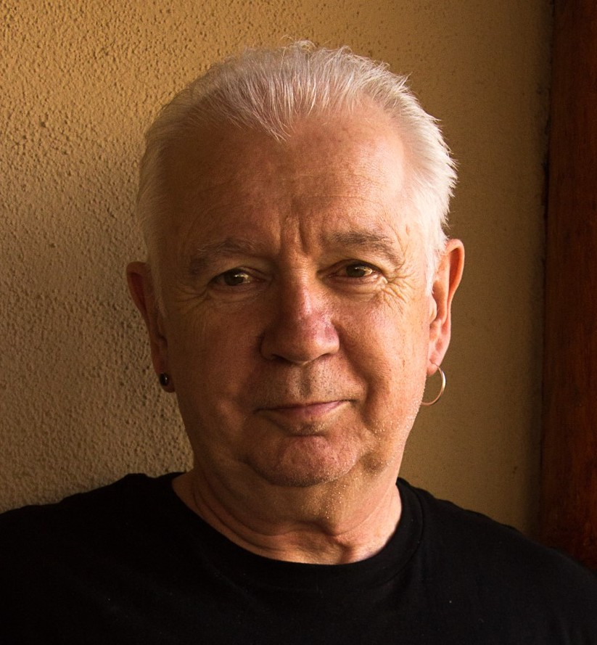
The (White) Elephant in the Room Another White man leading something on race – doesn’t this underscore the power of Whiteness?
The problem of race is the problem of unchallenged white supremacy – its idea & practice
At the heart of racism is the fact that many White folks such as Stephen Brookfield have not examined what it means to have a White racial identity
White students & colleagues need to see us typically & unremarkably center racial dynamics as a factor in teaching & leadership
Diversity, equity & inclusion (DEI) work best involves cross-racial conversations & alliances – facilitated by a team of colleagues of different racial identities

Slide 5
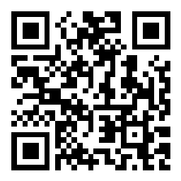
TO POST QUESTIONS AS THE KEYNOTE PROCEEDS…
Go to sli.do
Enter Code 2654921
Or use the QR code opposite
Post your question – it’s ANONYMOUS

Slide 6
Transformation A shift in the tectonic plates of our perspectives & institutional practices Fundamental & Irreversible The world is never the same

Slide 7
Identifying & Challenging White Supremacy
The belief that Whites’ possess a superior innate intelligence because they exercise reason, logic & objectivity
Their ability to stay calm in a crisis means they should therefore be in charge of making decisions for ALL people.
People of Color are contrasted as being emotional, unpredictable, volatile & unreliable – that means they should be kept as far away from the reigns of power as possible
Systems function to underscore this mythology without it ever being named

Slide 8
Sometimes this results in ‘Performative’ or ‘Counterfeit’ transformation
Changing brochures & web site to feature under-represented groups – a rainbow coalition of different racial identities
Issuing 5 or 10-year plans for the future
New mission statement that emphasizes a commitment to transformation
Press releases laying out the organizations commitments
Multiple workshops

Slide 9
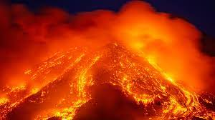
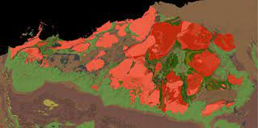
Does the institution change its fundamental structure and processes? Is its reason for existing fundamentally altered? Do the tectonic plates irrevocably shift?

Slide 10
Dynamics of Transformational Change - Modeling
Those in positions of power and authority – senior leadership team, CEO, Board members, President – publicly model their commitment to anti-racism
State of the Institution annual address or Convocation involves President & board members talking about how their racial identities structure their days
President gives up his office to house a center for inclusive excellence or antiracism
Dept. chairs insist on instituting an “equity pause” in meetings (Before program decisions are made ask who benefits from the decisions, whose voices are NOT at the table, who is missing, & how do we get them in the room?)

Slide 11
Dynamics of Transformational Change – Reward Structures
Behaviors that are rewarded focus on how people commit to the practice of antiracism
Making racism & racial identity an explicit curricular focus
Willingness to disclose publicly one’s own struggles around dealing with, & teaching about, racism
Making ‘failing well’ a prized behavior – documenting for colleagues how our attempts to work in antiracist ways go awry, & what we learn from that
Making team teaching and collaborative work the preferred way of teaching
Providing extra remuneration &/or a readjustment of responsibilities for members working to support transformation
Adjust time-off policies to offer recovery time to those traumatized by consistent transformative work
Add anti-racist assessment in annual evaluations, promotion, and tenure

Slide 12
HIRING
Publicly specify targets regarding hiring a percentage of BIPOC across the units, offices and departments of the college
Consider Cluster Hires so not to isolate/tokenize BIPOC recruits
Make evidence of commitment to, & the practice of, antiracism a key indicator of readiness to work
Consider documented antiracist work in reappointment and promotion decisions
Reward as particularly meritorious a commitment to, & practice of, antiracism in annual assessments, performance appraisals, employee reviews and annual reports
Provide extra remuneration &/ or a reallocation / readjustment of duties & responsibilities for staff, faculty and administration working to support & advance antiracism

Slide 13
Challenging the Eurocentric Paradigm
Individualism – give greater credit to those who teach in teams, make multi-authored pieces carry more weight, group projects, assessments & collaborative dissertations
Text – develop alternative evaluation formats that assess learning & performance via oral expression, demonstration, artistic & aesthetic experiments (Dancing your Physics Ph.D – John Bohannon)
“Bourgeois decorum” (bell hooks) in the classroom – don’t conclude that expressions of righteous anger or deep pain mean you’ve ‘lost control’
Silence – structure silent interludes in meetings & classrooms
Success – is keeping a difficult conversation going in which we learn to live with different realities. It’s NOT coming to consensus &/or group hugs

Slide 14
Decision-Making Procedures
Expand committee membership to be more representative & inclusive
Use Protocols that provide an opportunity for all to participate – circle of voices, chalk-talk, Bohmian dialog, circular response, anonymous social media (sli.do, backchannelchat)
Emphasize listening & hearing others’ perspectives – beware of universalizing your own experience
Become comfortable with an embrace of silent pauses for thought, processing & reflection
Recognize that strong emotions & feelings will be integral to the discussion such as anger, sadness, frustration, fatigue

Slide 15
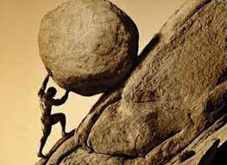
RESISTANCE will be your permanent reality
Discomfort at paradigmatic assumptions being challenged
Fear at what this means for people’s prospects within the organization
Resentment at the messengers
Denial of the need for change as people cling desperately to old ways of thinking & being
Sabotage as people attack the credibility of those initiating the process
Constant objections, questions, calls for review – delaying tactics
Accusations of anti-democratic, totalitarian practice

Slide 16
FINAL THOUGHTS
There are only two ways to do antiracism
BADLY…or NOT AT ALL
It will take decades…not years
It will never happen in the way you plan
Success is keeping the conversation going

Slide 17
Some Resources Authored by Stephen
Becoming a white antiracist: A practical guide for educators, leaders & activists. 2021. Sterling, VA: Stylus (w/Mary Hess)
Gospel Beautiful Podcast: https://www.buzzsprout.com/680528/8460030-stephen-brookfield-and-mary-hess-becoming-a-white-antiracist
Teaching race: Helping students unmask and challenge racism. 2019. Hoboken, NJ: Wiley Publishing
Anti-racism for White people (w/ Ali Smith): https://studentaffairsnow.com/
Becoming a critically reflective teacher. 2017 (2nd. Ed.). Hoboken, NJ: Wiley Publishing
Handbook of race and adult education. 2010. Hoboken, NJ: Wiley Publishing (w/ Vanessa Sheared, Juanita Johnson-Bailey, Scipio Colin Jr III, & Elizabeth Peterson)
The discussion book: 50 great ways to get people talking. 2016. Hoboken, NJ: Wiley Publishing (w/Stephen Preskill)
www.stephenbrookfield.com
(Go to “Resources”, “Creating an Anti-Racist White Identity” and “Recent Writings” links)

Slide 18
General Resources
Ijeama Oluo. 2019. So you want to talk about race. New York: Seal Press. https://www.youtube.com/watch?v=TnybJZRWipg
George Yancy. Look! A White (2012), What White Looks Like (2004), White self-criticality beyond anti-racism https://www.youtube.com/watch?v=fyZNAAr8czE
N.M. Joseph, C. Haynes and F. Cobb (Eds.). 2016. Interrogating Whiteness & relinquishing power: White faculty’s commitment to racial consciousness in STEM classrooms. New York: Peter Lang,
Layla F. Saad. 2020. me and White supremacy: Combat racism, change the world, and become a good ancestor. Naperville, IL: Sourcebooks. https://www.youtube.com/watch?v=gMEXBFhA-NY
Derald Wing Sue 2016. Race talk & the conspiracy of silence. Hoboken, NJ: Wiley https://www.youtube.com/watch?v=Nrw6Bf5weTM&t=53s
Shannon Sullivan. 2014. Good White people. Albany: SUNY Press https://www.youtube.com/watch?v=UZo06BjmbbE
Robin DiAngelo. 2018. White fragility. Boston: Beacon Press https://www.youtube.com/watch?v=45ey4jgoxeU
Ibram X. Kendi. 2019. How to be an anti-racist. New York: One World Books https://www.youtube.com/watch?v=TzuOlyyQlug
Glenn Singleton. 2014 Courageous conversations about race. Thousand Oaks, CA: Corwin https://www.youtube.com/watch?v=IwaOBXzJ3hs
Solomon, Akiba & Rankin, Kenrya. 2019. How we fight white supremacy: A field guide to black resistance. New York: Bold Type Books https://www.youtube.com/watch?v=Cc51rbZok3k
Tim Wise. 2011. White like me. Berkeley, CA: Counterpoint https://www.youtube.com/watch?v=N4fbr1LlxEk

