Slide 1
Dismantling white supremacy in a multiracial world: What white folks can do
Stephen Brookfield
http://www.stephenbrookfield.com/
Distinguished Scholar, Antioch University
(He, Him, His)
This power point is available for free download at http://www.stephenbrookfield.com/
Click on the ‘Resources’ link & it’s the 1st power point to come up

Slide 2
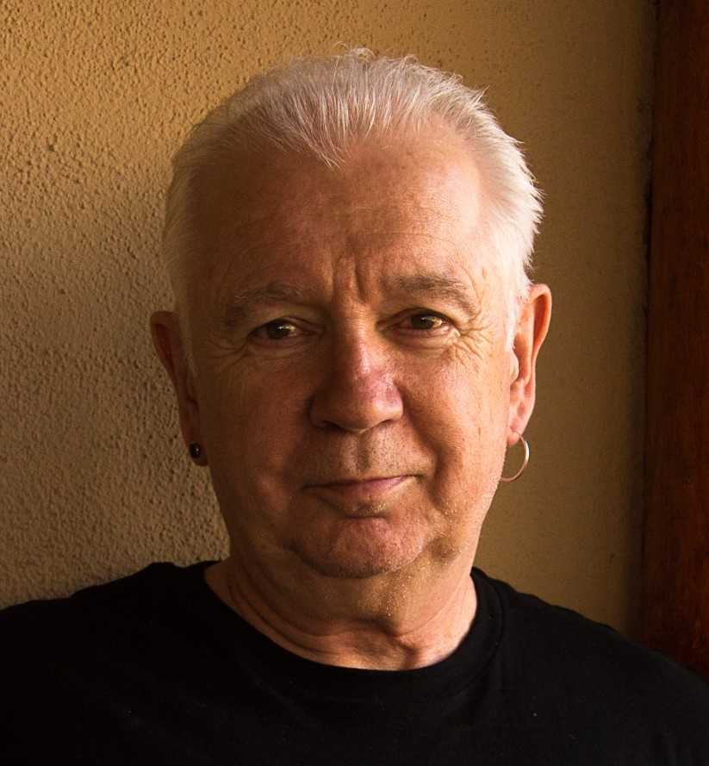
He, him, his Born in Liverpool, England (1949) Became American in 2002 Married with 2 children, both born in New York city Lived in St. Paul since 1992 Leads the pop punk band The 99ers (6 albums on Spinout Records) Struggling to become a white antiracist

Slide 3
How are we feeling about today?
Go to: sli.do.com
Enter Code: 18760
Choose a response

Slide 4
White Supremacy
Core Idea – because of their innately superior intelligence, ability to use reason & logic, & capacity for calm objective analysis, whites should be entrusted with the power & control to make decisions for everyone else. People of color are too unsophisticated, irrational & emotional to be entrusted with power. They have ‘soul’ and physical grace but are deemed not to possess intelligence & are driven by animalistic instinct. Their volatility, unpredictability & potential for violence makes their mass incarceration normal.
An unacknowledged component of white identity – if you are white assume that you, like me, have this idea in your consciousness at an unacknowledged level. You may think you are past it, but it’s in you.
This core idea ‘normalizes’ racism for ‘good whites’ – we may deplore racism but we enact it because of learned white supremacy

Slide 5
White supremacy & mental health
Most white antiracists say they do this work for social justice reasons – it’s just the right thing to do. But we also do it for selfish reasons…
We don’t want to live an alienated life built on a lie – the core idea of innate white superiority is so empirically unsupportable that it comprises a myth. Basing your life on a myth – even a powerful one – is untenable. At some level you know you’re living a lie & that something in your worldview is profoundly wrong.
We don’t want to live in constant fear – knowing at some deep level that innate white superiority is a myth, we live in fear of that myth being revealed for the fiction it is. Once that happens we imagine a race war & reprisals / retribution for the exercise of white power.
So it’s in whites best interests to dismantle white supremacy. We need to do this for our mental health as well as for the reasons we usually provide – social justice, democratic fairness, the fight against inhumanity & genocide etc.

Slide 6
“Good Whites” – like me (Stephen) * Believe we don’t see race * Believe we can monitor our own racism * Believe we treat everyone the same (colorblind ideology)
Believe we focus on actions & individual character, not racial identity
Choose when to engage in race and anti-racism
Believe we have a pure, anti-racist soul
Believe we are free of white supremacist conditioning
View racism as something committed by less enlightened whites
See white supremacy as ‘out there’ amongst uneducated, poor, working class whites
Regard ourselves as allies of people of color
(Shannon Sullivan Good White People 2014)

Slide 7
Behaviors of “Good Whites”
When confronted with examples of their learned racism, good whites will vigorously deny any racist intent, claim they have been misunderstood, are acting innocently, & are being unfairly accused
Will become defensive & immediately seek to explain to people of color the “real” meaning of their behavior
Will resist “sitting with” the reality that they have learned racism & white supremacy throughout their lives & carry those viruses
Will accuse people of color of imagining things, seeing racism where it doesn’t exist, & denying the validity of whites’ experience
Will come to each other’s defense in multi-racial discussions
I know this because these are all of my learned behaviors
(Robin DiAngelo White Fragility 2018)

Slide 8
In the Context of White Supremacy Whites Need to Understand…..
(1) How white supremacy as a dominant ideology is learned and transmitted and presented as the ‘normal’ way of understanding the world. How it’s internalized as a white racial frame*
(2) How white supremacy is embedded in institutional functioning – policies, structures, protocols, habits
(3) How “good” whites who are unaware of this reality & who think of themselves as moral beings can be brought to understand it
(4) How to develop an antiracist positive white identity – where whiteness is not a source of overwhelming shame and guilt
(5) How to challenge & dismantle white supremacist systems
*The White Racial Frame Joe Feagin (2013, 2nd. Ed.)

Slide 9
Working Antiracist White Assumptions
I MUST…
Call out racist behavior (including in myself) as soon as I see it. If I don’t I will have no credibility in the eyes of students and colleagues of color.
Assume that for students and colleagues of color EVERYTHING is seen through the lens of race. For them, NOTHING is “race free”.
Acknowledge my own racist behavior when it’s pointed out to me – not try to ‘explain’ it away, not protest my innocence: I must regard it as truth.
I MUST NEVER…
Try to talk people of color “out of” their testimony of racism.
Invoke “being respectful” or “seeing all sides of this” as a way of avoiding painful truths about my own socialization into, & learning of, racism.
Claim to be an “ally” or anti-racist “friend”.
Ask people of color to teach me about racism or to tell me what I should do – figuring out what whites should do is OUR responsibility

Slide 10
For Whites - Be Wary of Expecting Approval
“I honestly have been having a hard time being in predominately white classes lately as people in this country realize, again, the issues that exist in America for Black people……
While she was giving her long spiel on her good work, I couldn't figure out where to place my feelings. I could see it from a mile away; I even prepped myself for it before the class. I prepared for THIS, but I still wasn’t ready.
Her actions were soooo predictable, well, to me. It was something I knew was bound to happen in a class placed right in the heart of the world grappling with whether or not Black lives matter.
But I still felt completely uncomfortable, sick. Now, I am not one to dim anyone's light, but all I felt like saying was, "oh, okay. That's cute. You want a cookie?" I couldn't help but think, "this is not something new, why is it new to you? Why are you just now having these conversations?"
I do not know this woman and may never have a class with her again; however, I will always remember what she did and how it made me feel.”
Carmina Maye 2020 I Really Wanted this to Be a Poem. (Dept. of Art & Art Education, Teachers College)

Slide 11
CLIMBING THE LADDER OF RACIAL CONVERSATIONS
Constant Check Ins
Scaffold – Micro-aggressions
Scaffold via Scenario Analysis
Constantly Explain Process out Loud
Use Structured Conversation Protocols
Use Video-testimony to Prompt Conversation
Prepare People for Brave Space
Define Your Terms via Narrative Experience
Build Relationships via Identity-Sharing*
Model Narrative Disclosure of Struggle
Take Emotional Temperature
*(I Am From, Story of My Name, Why This is Important to Me)

Slide 12
Some things white folk can do
Always say the unsayable – name white supremacy as an enduring institutional reality that a predominantly white institution (PWI) will inevitably be blind to
Constantly ask questions re. proposals, reforms, action plans etc. - What are we missing because we’re white? What’s blinding us from recognizing white supremacy? How does this proposal reduce or entrench active and passive racism at our institution?
Affirm & promote Black, Indigenous & People of Color (BIPOC) accounts of white supremacy (including digital technology) occurring in the institution
Show Up – meetings, task forces, protests, rallies, teach-ins (as appropriate)
Leverage your privilege & capital – be the first to raise racial questions; name white supremacy; be at the front & sides of multiracial BLM protests
Share insider knowledge of the white supremacist world – how to frame change initiatives draped in mission language & symbols; what we know of the idiosyncrasies of white power holders; how to hold the institution accountable in ways it can’t dodge
Hold white colleagues accountable – by citing yourself as a carrier of white supremacy; by establishing racism as a learned behavior embedded in the systems we move through everyday

Slide 13
Becoming a white antiracist means
Always feeling like you’re falling short
Always feeling like your whiteness means you’re unqualified to talk about race
Always feeling like you’re making mistakes getting it wrong
Readjusting how you define success – moving from Kumbaya transformations to keeping a difficult conversation going
Being fine with a lack of recognition/approval
Ultimately knowing there are two ways to do white antiracist work – IMPERFECTLY or NOT AT ALL

Slide 14
Stephen’s Resources
Becoming a White Antiracist (Stylus – Forthcoming, 2021) w/Mary Hess
Teaching Race (Jossey-Bass, 2019)
Powerful Techniques for Teaching Adults (Jossey-Bass, 2013)
Teaching for Critical Thinking (Jossey-Bass 2012)
Handbook of Race and Adult Education (Jossey-Bass, 2010) w/ Vanessa Sheared, Juanita Johnson-Bailey, Scipio Colin Jr III, & Elizabeth Peterson
The Power of Critical Theory (Jossey-Bass, 2004)
www.stephenbrookfield.com
(Go to “Becoming a White Antiracist”, “Recent Writings” & “Workshop Materials” links)

Slide 15
General Resources
Layla Saad – Me and White Supremacy (2020) https://www.youtube.com/watch?v=WgWTzUa4VrA
Ijeama Oluo – So You Want to Talk About Race (2019) https://www.youtube.com/watch?v=TnybJZRWipg
George Yancy - Look! A White (2012), What White Looks Like (2004), White Self-Criticality beyond Anti-Racism (2016) https://www.youtube.com/watch?v=fyZNAAr8czE
Derald Wing Sue – Race Talk & the Conspiracy of Silence (2016) https://www.youtube.com/watch?v=Nrw6Bf5weTM&t=53s
Shannon Sullivan – Good White People (2014) https://www.youtube.com/watch?v=UZo06BjmbbE
Robin DiAngelo – White Fragility (2018) https://www.youtube.com/watch?v=45ey4jgoxeU
Ibram X. Kendi – How to Be an Anti-Racist (2019) https://www.youtube.com/watch?v=TzuOlyyQlug
Glenn Singleton – Courageous Conversations About Race (2014) https://www.youtube.com/watch?v=IwaOBXzJ3hs
Tim Wise – White Like Me (2011) https://www.youtube.com/watch?v=N4fbr1LlxEk

