Slide 1
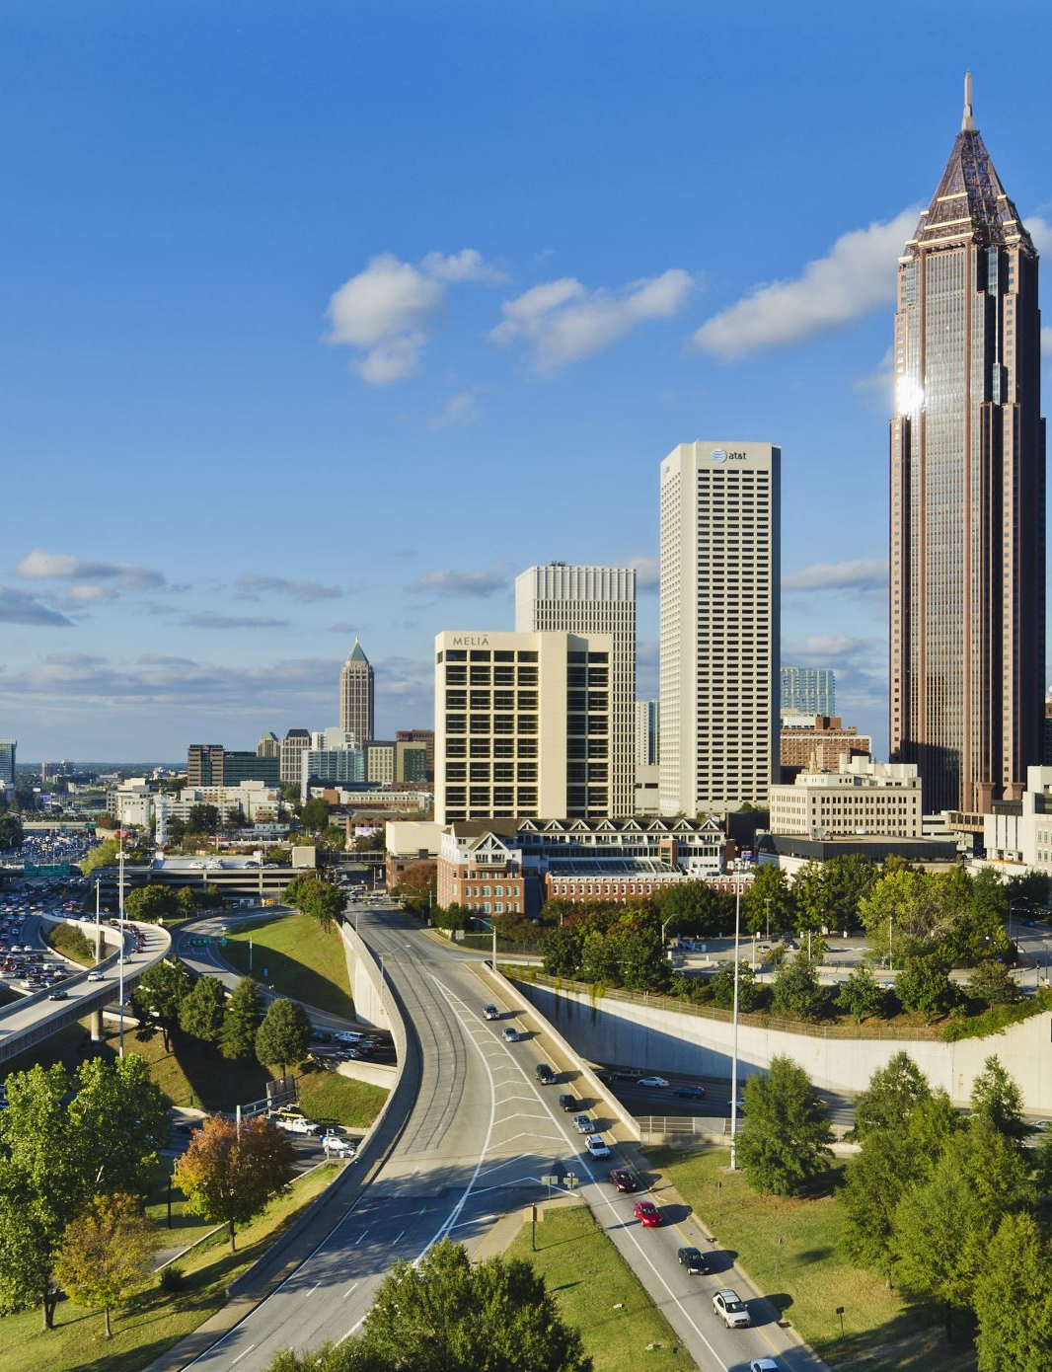
You can do this imperfectly or not at all: The dynamics of teaching race
Stephen Brookfield (he, him)
Distinguished Scholar, Antioch University
http://www.stephenbrookfield.com/

Slide 2
To access this power point…
Go to my home page: http://www.stephenbrookfield.com/
Click on the “Resources” link (top left, next to ‘Home’
Scroll down to power points & pdf’s http://www.stephenbrookfield.com/powerpoints-pdfs
This power point is the 1st one listed – “You Can Teach Race Imperfectly or Not at All”
Feel free to steal anything from my home page – it’s open access for free download

Slide 3
USING sli.do
Go to sli.do
Enter Code 459765
Click on Q&A & type in your question
TO POST ANONYMOUS QUESTIONS AS THE KEYNOTE PROCEEDS

Slide 4
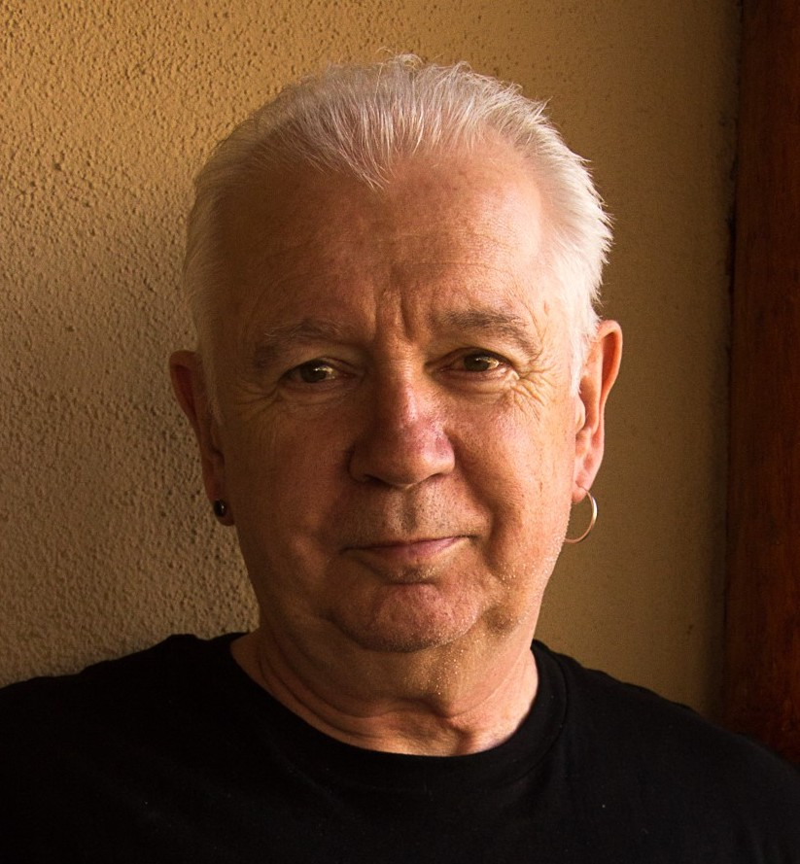
The (White) Elephant in the Room Another White man leading something on race – doesn’t this underscore the power of Whiteness?
The problem of race is the problem of unchallenged white supremacy – its idea & practice
At the heart of racism is the fact that many White folks such as Stephen Brookfield have not examined what it means to have a White racial identity
White students & colleagues need to see us typically & unremarkably center racial dynamics as a factor in teaching & leadership – “equity pause” in meetings
Diversity, equity & inclusion (DEI) work often involves cross-racial conversations & alliances – facilitated by a team of colleagues of different racial identities

Slide 5
I Am From…*
the sound of seagulls crying over the north sea and merseybeat blasting at the Cavern club,
the smell of fish & chips, factory waste and coal burning fires,
the taste of grease, sour milk tea and dust at the back of my throat
the idea of community pride & the triumph of humor over pretentiousness
* Adapted from the poem Where I’m From by George Ella Lyon

Slide 6
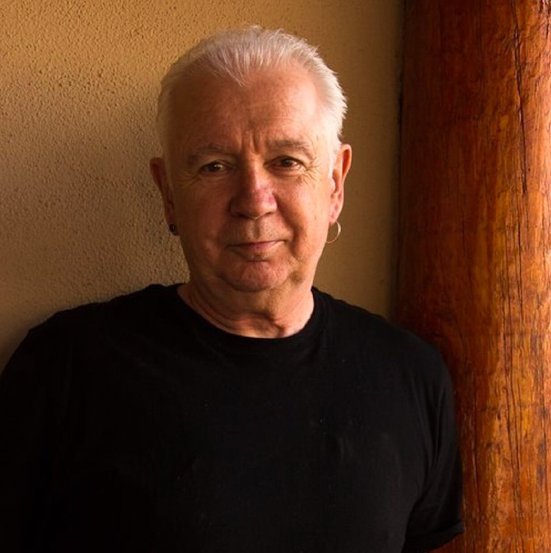
Situating Myself Racially
Born into a White family in Liverpool, England & grew up in the UK Did not speak to anyone who wasn’t White until I was 18 Spent over half my life regarding myself as a “Good White Person”* who has escaped racism with a color-blind perspective Will never lose the White supremacist conditioning I’ve received - this asserts that leaders & power ‘naturally’ look white because Whites have a higher capacity to use reason, logic, stay calm & make objective decisions. This is why they deserve to be in control. It also maintains that Black, Indigenous & People of Color (BIPOC) are too emotional, volatile & unpredictable to be given access to power Will always feel “unqualified” to talk about racism - & then remind myself I’m an expert on how white supremacy is learned Believe that Whites like me need to develop an antiracist identity** *Shannon Sullivan. 2014. Good White People (SUNY Press) ** Stephen Brookfield & Mary Hess. 2021. Becoming a White Antiracist (Stylus)

Slide 7
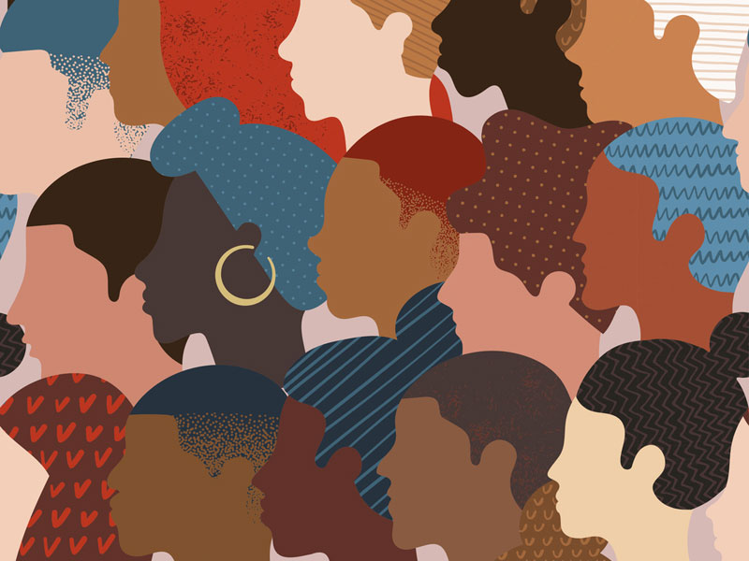
Why Spend So Much Time on ME in the first few slides? Isn’t this incredible self-indulgence?
Because students say that if a teacher models autobiographical disclosure around racial identity, & publicly engages with issues of race – it makes it MUCH easier for students to raise any concerns they have around racial dynamics in the classroom

Slide 8
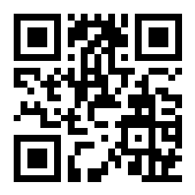
Let’s try a social media tool Go to sli.do Enter Code: 18670 Or use the QR code opposite (if you’re using a smart phone) Give your response to the following question: As we move into talking about race I feel....

Slide 9
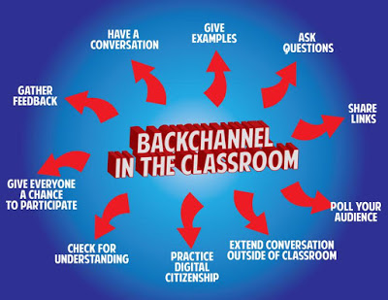
Pose a question at start of class to assess what knowledge, experience & preconceptions students bring Pose quick questions during class to check for understanding, identify misconceptions Invite students to raise questions or seek clarification anonymously Interrupts the normal privileging of speech, extroverts, dominant language speakers – no one can dominate Anonymity means students aren’t afraid to ask ‘dumb’ questions As with all activities, open to sabotage sli.do backchannelchat.com tweedback.de

Slide 10
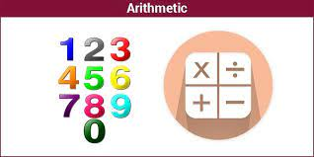
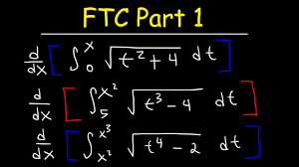
So What Can We Expect in a Multiracial classroom? An arithmetic level of understanding of the dynamics of pervasive, structural racism amongst many whites who have not thought much about racial identity & whiteness THIS IS A REASON FOR AFFINITY GROUPS
A calculus level of understanding amongst Black, Indigenous and People of Color (BIPOC) who have negotiated the dynamics of structural racism & white supremacy all their lives
TIRED OF WITNESSING ‘WOKENESS’

Slide 11
Witnessing White ‘Wokeness’
“I honestly have been having a hard time being in predominately white classes lately as people in this country realize, again, the issues that exist in America for Black people.
While she was giving her long spiel on her good work, I couldn't figure out where to place my feelings. I could see it from a mile away; I even prepped myself for it before the class.
I prepared for THIS, but I still wasn’t ready. Her actions were soooo predictable, well, to me. It was something I knew was bound to happen in a class placed right in the heart of the world grappling with whether or not Black lives matter. But still I felt completely uncomfortable, sick.
Now, I am not one to dim anyone's light, but all I felt like saying was, "oh, okay. That's cute. You want a cookie?"
I couldn't help but think, "this is not something new, why is it new to you? Why are you just now having these conversations?"
I do not know this woman and may never have a class with her again; however, I will always remember what she did and how it made me feel.”
Carmina Maye 2020 I Really Wanted this to Be a Poem. (Dept. of Art & Art Education, Teachers College)

Slide 12
How students of color experience predominantly White spaces – Some working assumptions
This is an unsafe space as regards us raising questions or issues around race
It’s better for us to stay silent than risk being regarded as troublesome or playing the race card
We feel there are constant unspoken assumptions being made about our intellectual capability based on my racial identity
Where are BIPOC amongst faculty and leadership?
Where are BIPOC only spaces where we can engage in ‘real’ talk about survival?
Why don’t White folks raise questions of race? Why do we always have to do this?
Please stop asking us to educate you about this
Please stop showing us how ‘woke’ you are
Please show us that you take equity seriously in your public actions

Slide 13
WHITE AFFINITY GROUPS No need to prove oneself as a “good, woke White person” – or to declare allyship No opportunity to ask BIPOC to educate White people on race Lessens fear of saying the ‘wrong’ thing in front of BIPOC peers Removes temptation to ‘confess’ to racism & ask absolution from BIPOC
BIPOC AFFINITY GROUPS
No need to ‘take care’ of sensitivities of White egos
Chance to relax in real talk around experiences of racism
Can develop support networks & provide emotional sustenance
Share knowledge of negotiating the White power structure
No requests to ‘teach’ Whites about race

Slide 14
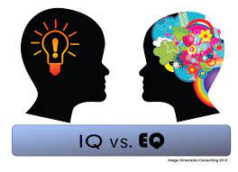
TWO KINDS OF PREPARATION FOR TEACHING & LEADING AROUND RACE
Technical (Content) – reading, viewing, thinking, reflecting on nature of racism, white identity, white supremacy, anti-blackness etc.
Technical (Process) – how to model disclosure, choose good narratives, build trust, scaffold learning from simple to complex, use protocols
Emotional (EQ) – this is inherently emotional work in which people are laying bare their identities, experiences, convictions and feelings. It will sometimes be raw & contentious and people will become distressed, angry, and uncomfortable
Emotional (Mistakes) – this is inherently unpredictable work & you’ll constantly feel like you’ve screwed up, made mistakes, said or done the wrong thing, and mishandled situations
Two ways to address race, racism, racial dynamics…. IMPERFECTLY or NOT AT ALL!

Slide 15
How to Prepare for Teaching with Race in Mind
Lose Your Desire/Expectation to address this issue ‘Perfectly’
Begin By Modeling Self-Disclosure Around Your Own Racial Identity/Struggles
When Possible Teach & Model Racial Cross-Talk as a TEAM
Consider Using Digital Narratives*
Take the Emotional Temperature –sli.do, Mood Meter
Introduce the Concept of Brave Space
Consider Introducing Racial Affinity Groups
Use Conversational Protocols to Engage Everyone
(Circle of Voices, Circular Response, Bohmian Dialogue)
Check In Regularly via Anonymous Channels
(sli.do, backchannelchat.com)
* Letter to White America (George Yancy) https://opinionator.blogs.nytimes.com/2015/12/24/dear-white-america/
* What it Means to be American (Color of Fear) https://www.youtube.com/watch?time_continue=3&v=2nmhAJYxFT4&feature=emb_logo
* Conversations on Race (New York Times) https://www.nytimes.com/interactive/projects/your-stories/conversations-on-race
* How Can We Win (Kimberly Latrice Jones) https://www.youtube.com/watch?v=ZkedkvNn5V0

Slide 16
Some Possible Interim Goals to Work For
Cluster hires of BIPOC faculty, administrators & staff
BIPOC-only support spaces
Student evaluations of teachers – how did this course/instructor bring issues of race into this course? How did they model an engagement w/ racial identity?
Equity Pauses – in every meeting before decisions are discussed
Modeling from Senior Leadership – includes Trustees, Governors
Multiracial Team Teaching – bringing different positionalities & dynamics into direct focus / modeling open conversation that lives with difference
How antiracist efforts are rewarded – teaching, scholarship, professional development, personal growth
Alternatives to Eurocentric epistemology – oral communication, collaborative dissertations, non-textual aesthetics (music, dance, poetry, collage, photos)

Slide 17
Some Resources Authored by Stephen
Becoming a white antiracist: A practical guide for educators, leaders & activists. 2021. Sterling, VA: Stylus (w/Mary Hess)
Gospel Beautiful Podcast: https://www.buzzsprout.com/680528/8460030-stephen-brookfield-and-mary-hess-becoming-a-white-antiracist
Teaching race: Helping students unmask and challenge racism. 2019. Hoboken, NJ: Wiley Publishing
Anti-racism for White people (w/ Ali Smith): https://studentaffairsnow.com/
Becoming a critically reflective teacher. 2017 (2nd. Ed.). Hoboken, NJ: Wiley Publishing
Handbook of race and adult education. 2010. Hoboken, NJ: Wiley Publishing (w/ Vanessa Sheared, Juanita Johnson-Bailey, Scipio Colin Jr III, & Elizabeth Peterson)
The discussion book: 50 great ways to get people talking. 2016. Hoboken, NJ: Wiley Publishing (w/Stephen Preskill)
www.stephenbrookfield.com

Slide 18
General Resources
Ijeama Oluo. 2019. So you want to talk about race. New York: Seal Press. https://www.youtube.com/watch?v=TnybJZRWipg
George Yancy. Look! A White (2012), What White Looks Like (2004), White self-criticality beyond anti-racism https://www.youtube.com/watch?v=fyZNAAr8czE
N.M. Joseph, C. Haynes and F. Cobb (Eds.). 2016. Interrogating Whiteness & relinquishing power: White faculty’s commitment to racial consciousness in STEM classrooms. New York: Peter Lang,
Layla F. Saad. 2020. me and White supremacy: Combat racism, change the world, and become a good ancestor. Naperville, IL: Sourcebooks. https://www.youtube.com/watch?v=gMEXBFhA-NY
Derald Wing Sue 2016. Race talk & the conspiracy of silence. Hoboken, NJ: Wiley https://www.youtube.com/watch?v=Nrw6Bf5weTM&t=53s
Shannon Sullivan. 2014. Good White people. Albany: SUNY Press https://www.youtube.com/watch?v=UZo06BjmbbE
Robin DiAngelo. 2018. White fragility. Boston: Beacon Press https://www.youtube.com/watch?v=45ey4jgoxeU
Ibram X. Kendi. 2019. How to be an anti-racist. New York: One World Books https://www.youtube.com/watch?v=TzuOlyyQlug
Glenn Singleton. 2014 Courageous conversations about race. Thousand Oaks, CA: Corwin https://www.youtube.com/watch?v=IwaOBXzJ3hs
Solomon, Akiba & Rankin, Kenrya. 2019. How we fight white supremacy: A field guide to black resistance. New York: Bold Type Books https://www.youtube.com/watch?v=Cc51rbZok3k
Tim Wise. 2011. White like me. Berkeley, CA: Counterpoint https://www.youtube.com/watch?v=N4fbr1LlxEk

