Slide 1
Creating an Antiracist White Identity in White spaces
Stephen S. Brookfield and Mary E. Hess
Virtual Conference November 13, 2020

Slide 2
Presenters:
Stephen
Mary
Producers:
Angela
Karmit

Slide 3
goals for today
explore how to advocate for the continual necessity of examining racism & white supremacy in predominantly white environments where race is only regarded as important when a crisis develops
introduce beginning techniques to bring whites ‘on board’ in the analysis of race
identify common traps and mistakes that white educators, leaders & activists make in advocating for racial justice
specify ‘must do’ steps & strategies in introducing racial analysis

Slide 4
specific exercises to explore and take with you
slido / live polling
ways to use chat
somatic breathing
circle of voices protocol

Slide 5
live polling to gauge emotional temperature
use live polls to increase engagement and attention, and to share with the group an overall sense of what is present
try this one: go to sli.do and enter the code 18760 (you have 60 seconds)
“when I know we’re going to talk about race, I feel….”

Slide 6
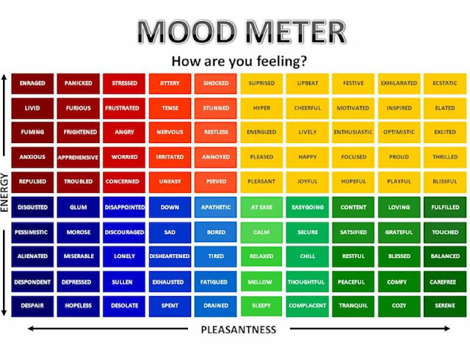

Slide 7
here’s a moment when you can go to the zoom chat — add a word or two from mood meter about your emotional temperature there

Slide 8
breathing …
racialized oppression in the US in particular is founded in a deep denigration and destruction of persons who have Black, Indigenous, Asian, and other body forms
we know this is not biological but rather socially constructed, and a key element in that social construction teaches persons with White bodies not to attend to our embodiedness — we don’t ‘see race’ and hence we are intentionally numbed and taught not to feel deeply (cf. white body supremacy and trauma)
a first step in the journey back towards full embodiedness begins in one’s own body awareness, and a very first step is attending to breath — we all must breathe, and we are living in a moment in which the cry “I can’t breathe!” has enormous resonance
Resmaa Menakem in MN is a leader in this work (My Grandmother’s Hands)

Slide 9
4 : 7 : 8 exercise
for this moment simply try this small breath exercise: breathe in slowly to the count of four, hold your breath for a count of seven, and then exhale through your mouth to a count of 8
(count as quickly or slowly as you need to, but keep the pattern of breathing out more slowly through your mouth then you breathe in through your nose)

Slide 10
chat conversation
another way to use a chat is to ask a specific, targeted question as a way to generate conversation
this is a way to check your assumptions and spark some engagement
“What do you think BIPOC communities most want white folx to do as they contribute to racial struggle?”

Slide 11
“I honestly have been having a hard time being in predominately white classes lately as people in this country realize, again, the issues that exist in America for Black people…… While she was giving her long spiel on her good work, I couldn't figure out where to place my feelings. I could see it from a mile away; I even prepped myself for it before the class. I prepared for THIS, but I still wasn’t ready. Her actions were soooo predictable, well, to me. It was something I knew was bound to happen in a class placed right in the heart of the world grappling with whether or not Black lives matter. But still felt completely uncomfortable, sick. Now, I am not one to dim anyone's light, but all I felt like saying was, "oh, okay. That's cute. You want a cookie?" I couldn't help but think, "this is not something new, why is it new to you? Why are you just now having these conversations?" I do not know this woman and may never have a class with her again; however, I will always remember what she did and how it made me feel.”
(Carmina Maye, 2020 I Really Wanted this to Be a Poem. Dept. of Art & Art Education, Teachers College)

Slide 12
modeling narrative disclosure as an entry point for white antiracism — leading by sharing our own learning

Slide 13
circle of voices discussion protocol
start with silently taking notes to yourself on this question: “What are the best approaches to engaging white colleagues or students in discussions of race that you’ve witnessed or enacted?”
in the breakout each person has up to 1 minute of uninterrupted air time to give their response to the question based on the notes they have made, no interruptions are allowed (try going in alphabetical order based on the name in your zoom window)
after all have spoken, move into free discussion (anyone can speak) but make sure that every comment you offer somehow refers back to a comment made by someone else in the opening circle of voices; this need NOT be an agreement - it can be a disagreement, a question, an elaboration or extension, an illustration
when you come back be ready to post an insight from your group in the shared chat

Slide 14
harvesting insights

Slide 15
for instance…
we talk about our own racial micro aggressions, the ways we’ve learned racism, how we’ve identified and tried to set aside stereotypes in our own lives
we work to be clear about how we have — and often continue to — comply with white supremacy even as we seek to dismantle it
we share how inherently unpredictable this work is and how we often feel like we’ve screwed up, made mistakes, said or done the wrong thing, and mishandled situations

Slide 16
things we wish we’d known earlier…
this is inherently emotional work in which people are laying bare their identities, experiences, convictions and feelings. It can be raw and contentious, with people will becoming distressed, angry, and uncomfortable
we don’t expect to reach a state of antiracist grace – we understand that we have learned racism and to some extent it will always be within us. The best we can do is to anticipate and try to push back against its influence on our actions.
be wary of seeking approval
breathe!

Slide 17
There are two ways do anti-racist work – imperfectly or not at all!

Slide 18
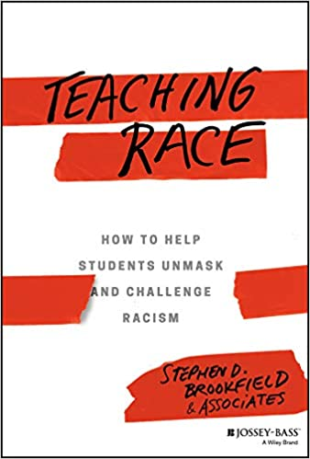
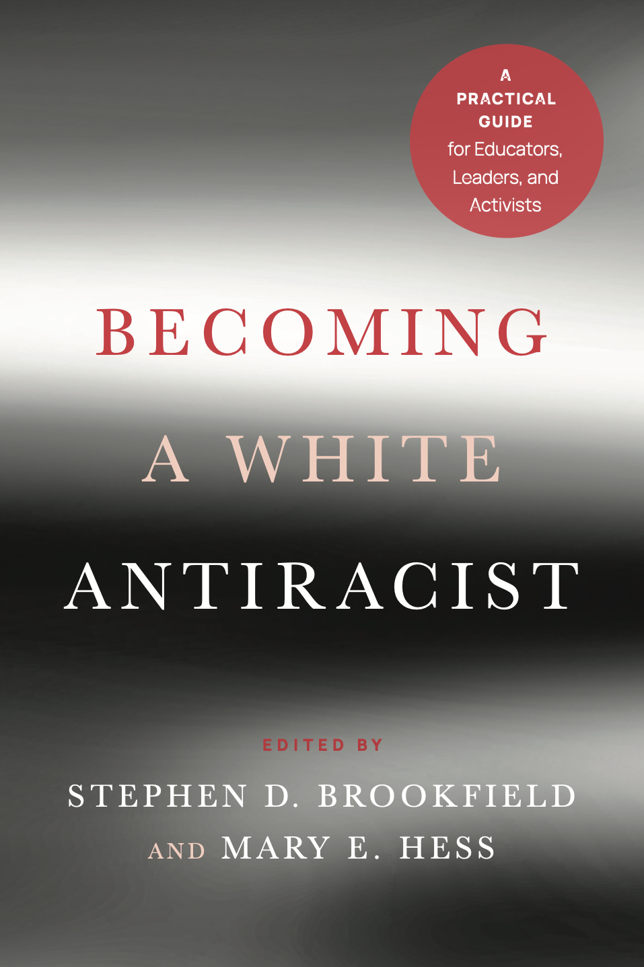
Stay in touch!
stephenbrookfield.com
meh.religioused.org

