Slide 1
How white supremacy functions to deny its existence: The white house defunding of antiracist staff & professional development
Stephen Brookfield
http://www.stephenbrookfield.com/
Distinguished Scholar, Antioch University
(He, Him, His)

Slide 2
www.backchannelchat.com
Go to www.backchannelchat.com
For Your Display Name – please use only NUMBERS to ensure anonymity
Enter Code – z2xa4
Please post a greeting to everyone so we know it’s working okay

Slide 3
Resources for this Presentation
http://www.stephenbrookfield.com/ - free access website, no need to ask my permission to download anything from it
The Power of Critical Theory (Jossey-Bass/Wiley, 2004)
Teaching Race (Jossey-Bass/Wiley, 2019)
Becoming a White Antiracist (Stylus, 2021, Forthcoming)
“Repressive Tolerance and the 'Management' of Diversity" In, V. Wang (Ed.). Critical Theory and Transformative Learning. Hershey, PA: Information Science Publishing (2018) (Available for free download from my website – go to the ‘Recent Writings’ link and scroll down until you see it.

Slide 4
The prompts for this presentation….
https://www.vox.com/2020/9/5/21423969/trump-federal-antiracism-training-critical-race-theory-white-privilege
https://www.nytimes.com/2020/09/17/us/politics/trump-patriotic-education.html
Note: https://edsource.org/2020/california-schools-chiefs-end-hate-initiative-prompts-contrast-with-president-trump/640437

Slide 5
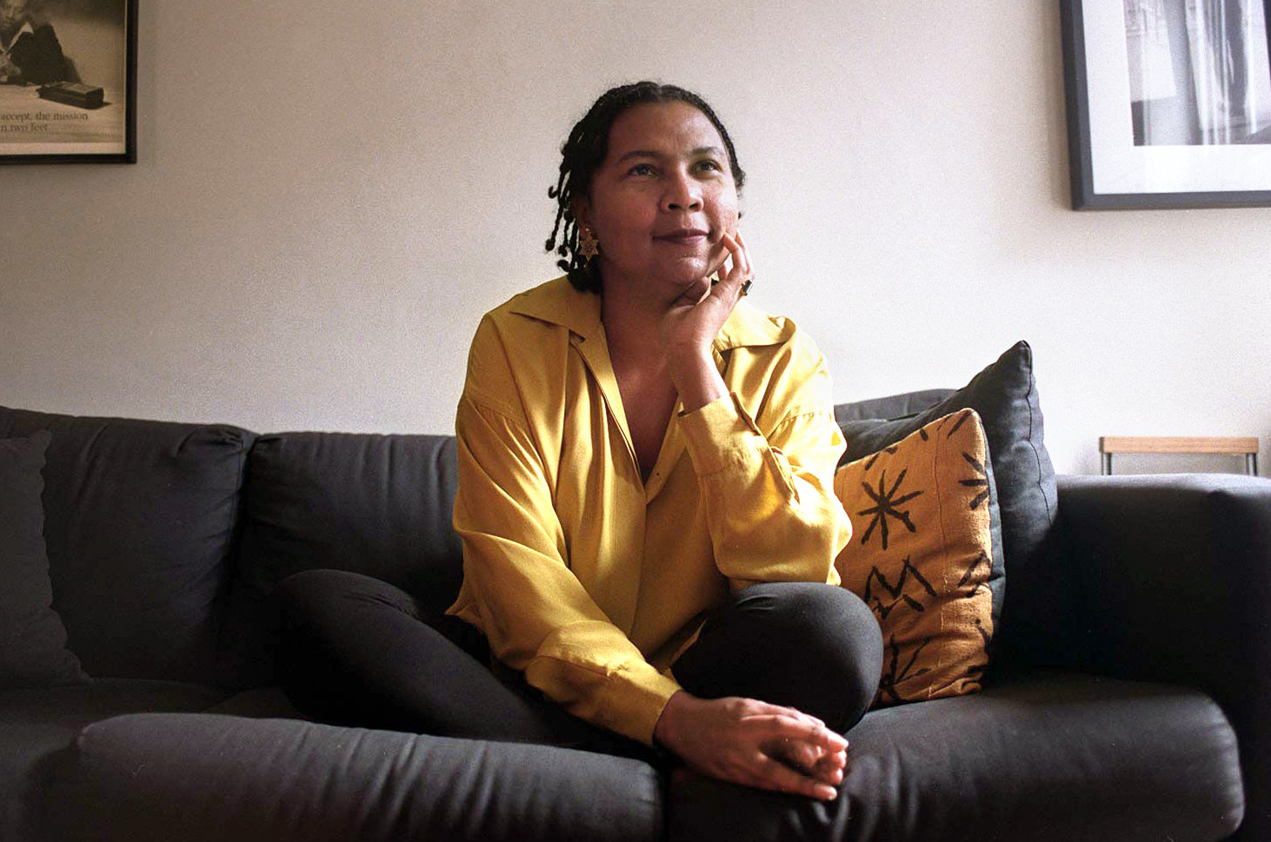
“I came to theory because I was hurting – the pain within me was so intense that I could not go on living. I came to theory desperate, wanting to comprehend – to grasp what was happening around and within me. Most importantly, I wanted to make the hurt go away. I saw in theory then a location for healing” (p. 59). Teaching to Transgress (1994) bell hooks

Slide 6
Four theoretical tools to make sense of the Trump administration’s pronouncements
White Supremacy – the idea that whites, because of their supposedly innate higher intelligence & ability to use reason & logic, should naturally be in positions of power & authority & in charge of calmly & objectively making decisions for everyone.
It’s corollary: Anti-Blackness – the idea that black people, because of their supposedly innate unpredictability, volatility, emotionality & propensity for criminality & violence, should be kept as far from the centers of decision-making & power as possible
Repressive Tolerance – the process by which institutions appear to take seriously challenges to their legitimacy through public gestures, virtue signaling and symbolic actions. Yet structurally no substantial change occurs in terms of policies, practices and institutional functioning
Liberating Tolerance – the deliberate & sustained immersion in alternative viewpoints and/or practices. For example, a course on how adults learn would draw only on an Africentric paradigm, on Critical Latinx theory, or on Indigenous perspectives

Slide 7
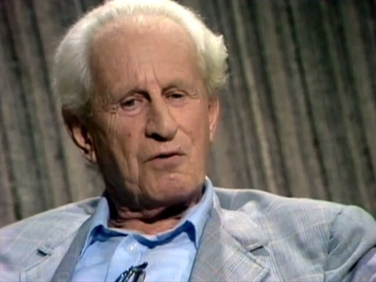
https://www.marcuse.org/herbert/
https://www.marcuse.org/herbert/publications/1960s/1965-repressive-tolerance-fulltext.html

Slide 8
In the Context of Racism & White Supremacy
Whites Need to Understand…..
(1) How white supremacy as a dominant ideology is learned and transmitted and presented as the ‘normal’ way of understanding the world. How it’s internalized as a white racial frame*
(2) How white supremacy is embedded in institutional functioning – policies, structures, protocols, habits
(3) How “good” whites who are unaware of this reality & who think of themselves as moral beings can be brought to understand it *
(4) How to develop an antiracist white identity
(5) How to challenge & dismantle white supremacist systems
*The White Racial Frame Joe Feagin (2013, 2nd. Ed.)
*Good White People Shannon Sullivan (2014)

Slide 9
Orienting Assumptions
I MUST call out racist behavior (including in myself) as soon as I see it. If I don’t I will have no credibility in the eyes of students and colleagues of color.
I MUST assume that for students and colleagues of color EVERYTHING is seen through the lens of race. For them, NOTHING is “race free”.
I MUST acknowledge my own racist behavior when it’s pointed out to me – not try to ‘explain’ it away, not protest my innocence: I must regard it as truth.
I MUST NEVER try to talk people of color “out of” their testimony of racism.
I MUST NEVER invoke “being respectful” or “seeing all sides of this” as a way of avoiding painful truths about my own socialization into, & learning of, racism.
I MUST NEVER claim to be an “ally” or anti-racist “friend”.
I MUST NEVER ask people of color to teach me about racism or to tell me what I should do – figuring out what whites should do is OUR responsibility

Slide 10
Helping Whites Move Into Racial Conversations
Frame the need for conversation in terms of the mission, purpose, strategic plan
Autobiographical disclosure -Talk about your own struggles with racism
Model a public inter-racial conversation between authority figures
Define terms early on – racism, white supremacy etc.
Set ground rules – brave space in which we challenge behavior not the person, expect emotional expression, anger & discomfort, & a lack of closure
Build community responsibility for conversation
Start with events & scenarios away from people’s experiences & then slowly move to a direct examination of personal/group experience
Use specific protocols – Bohmian dialog, methodological belief, circle of voices, circular response etc.
Create anonymous feedback backchannels for constant check-ins & evaluation – backchannel chat, sli.do, Critical Incident Questionnaire

