Slide 1
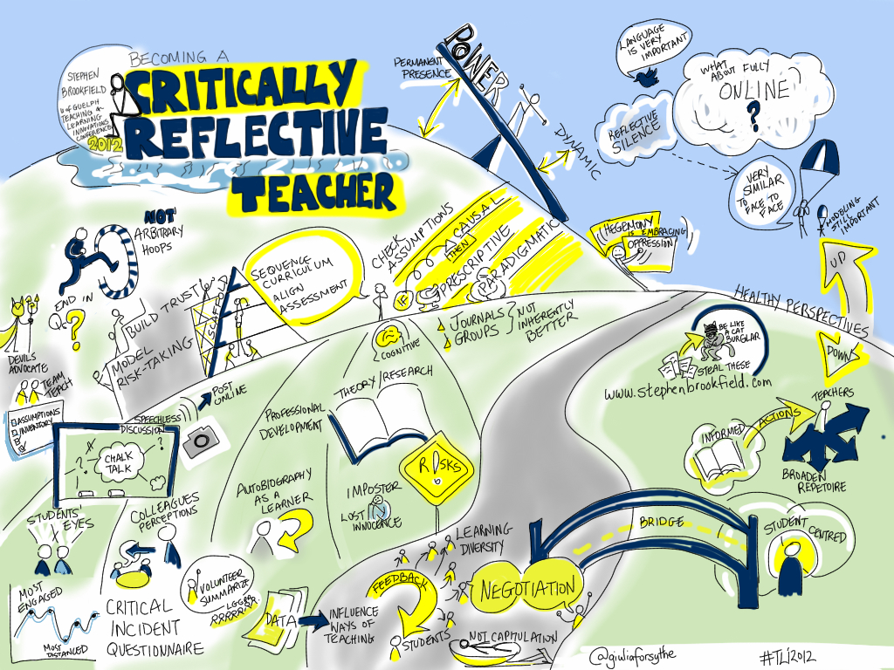
Becoming Critically Reflective - PDST March 4th, 2021 Stephen Brookfield (he, him, his) Distinguished Scholar, Antioch University

Slide 2
HOME PAGE - www.stephenbrookfield.com
My home page is open access so if you want to find out more about any of the exercises or activities I mention go to the page and click on the ‘Resources’ link.
Scroll down & you will find multiple PDF files of workshop packets stuffed with activities or power point files.
You do not need to ask my permission to use any of these resources. If they’re useful then please try them out and adapt them to your context.
To follow along today or retrieve these slides later click on ‘Resources’ link at top right of page.This presentation is the first power point listed.
www.stephenbrookfield.com

Slide 3
Sli.do
Go to: sli.do
Enter code: 66026
Please post any comments, reactions, critiques & questions you have as we go through this session

Slide 4
Who I am
I am from…
the sound of seagulls crying over the north sea and merseybeat blasting at the Cavern club,
the smell of fish & chips, factory waste and coal burning fires,
the taste of grease, sour milk tea and dust at the back of my throat
the idea of community pride & the triumph of humor over pretentiousness
Born in Bootle, Liverpool, 1949
Moved to the soft south as a teenager (mum hated Liverpool) - cultural genocide to rid me of Scouse accent
All education in UK, after graduation worked in FE & adult ed. (Lewisham, Slough, Devon, Worcestershire)
Lost my lecturer/organizer job in 1980 & fled (temporarily) to New York – a Thatcher political refugee
Met my partner there & moved to her home state – Minnesota – in 1992, raising 2 kids there
Left my university after dispute over antiracist efforts & lack of attention to white supremacy
Now the part-time “Distinguished Scholar” at Antioch University
Leader of The 99ers – pop punk band w/ 6 albums on Spinout Records (listen to us on Spotify, I Tunes, etc.)

Slide 5
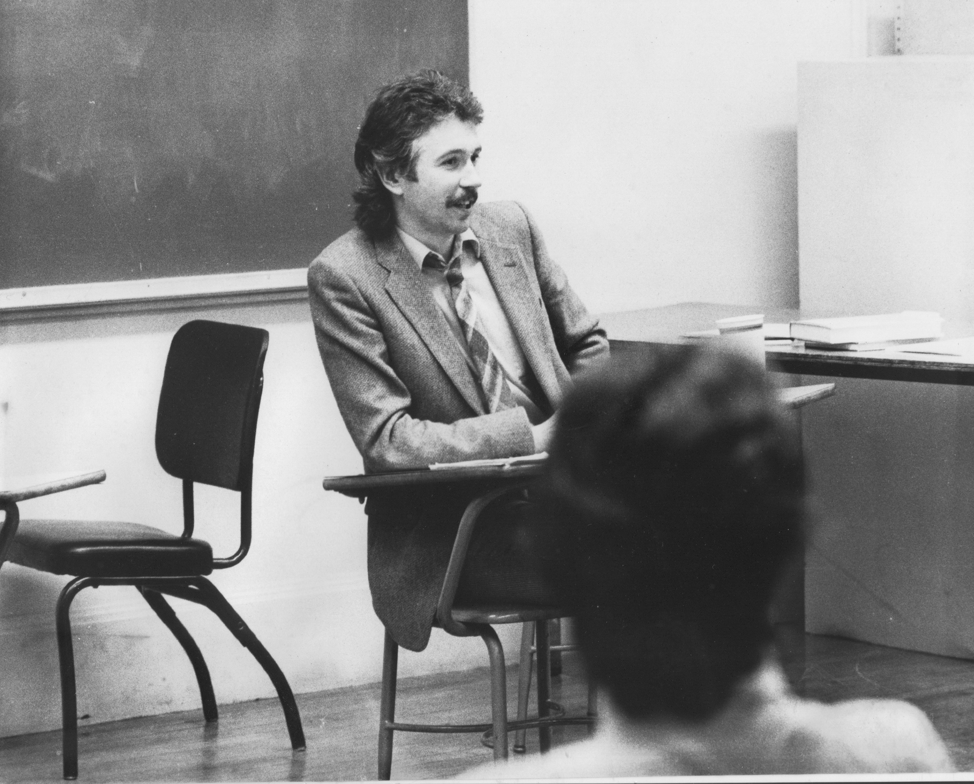
Situating Myself as a Teacher
History of academic mediocrity – poor grades in A levels, university places cancelled, College of Technology, graduated w/ lower second, failed my master’s degree exam – Broadening student-centered assessment measures
Watching my doctoral supervisor – giving me ‘bad’ inconvenient news in a way that I knew was in my own best interests
Ethical use of teacher power
Relational underpinnings
What constitutes trust?
Credibility / Authenticity
Limits to self-direction

Slide 6
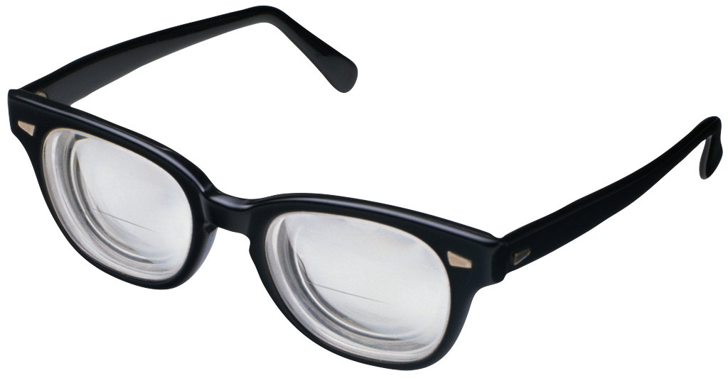
Process of Critical Reflection
Viewing our Practice through FOUR Lenses …
Students’ Eyes
Colleagues’ Perceptions
Theory
Autobiography

Slide 7
Core Assumptions
Good practice = whatever helps students learn
Best practice is critically reflective: uncovering assumptions via 4 lenses
Most important pedagogic knowledge: how people are experiencing their learning

Slide 9
Students Eyes’
ONE MINUTE PAPER
MUDDIEST POINT
AFTER HOURS GROUP
SOCIAL MEDIA –
(backchannelchat.com, tweedback.de, sli.do)
LEARNING AUDIT
CRITICAL INCIDENT QUESTIONNAIRE (CIQ)

Slide 10
Some things I’ve learned….
Power is always there
External inequities automatically reproduce themselves unless deliberately challenged
I can’t ‘wish away’ my power
Many practices I love & believe are democratic are experienced by students as surveillance & covert manipulation
You must first model whatever reflective processes you wish others to engage in
What seem like natural pedagogic instincts/impulses are framed by wider ideologies – patriarchy & white supremacy
Context is everything

Slide 11
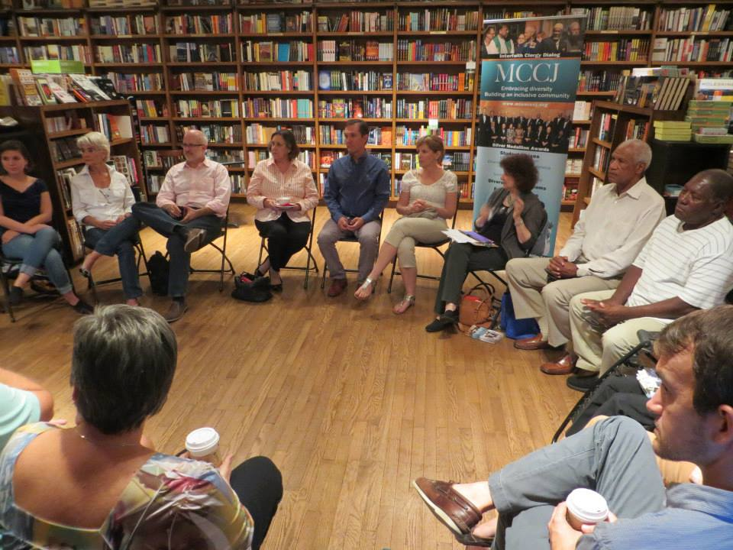

Slide 12
Assumptions: If I arrange chairs in a circle….
Students will feel their experience is respected & acknowledged when they walk in.
This will create a relaxed and congenial environment for learning
The distance between me as the teacher & them as the students will be reduced
Students will be more likely to participate, contribute, ask questions etc.

Slide 13
Students’ Perceptions
The circle is an arena of surveillance – everything I do will be seen, my mistakes will be noticed by everyone (peers & instructor)
The circle is alienating – if anything about me marks me out as different (how I look or sound) my discomfort is increased
The circle is coercion – you are forcing me to speak before you’ve earned the right to do that
The circle increases mistrust – I can’t sit back & judge your competence or authenticity, just let me process

Slide 14
Now….
I still use the circle but explain…
It’s to keep sight lines clear – so students who wish to contribute or ask a question can do that easily
It’s so students don’t have to talk to the back of other people’s heads
I won’t assume that those who are quiet are less diligent or intelligent
I must self-disclose before expecting students to do the same

Slide 15
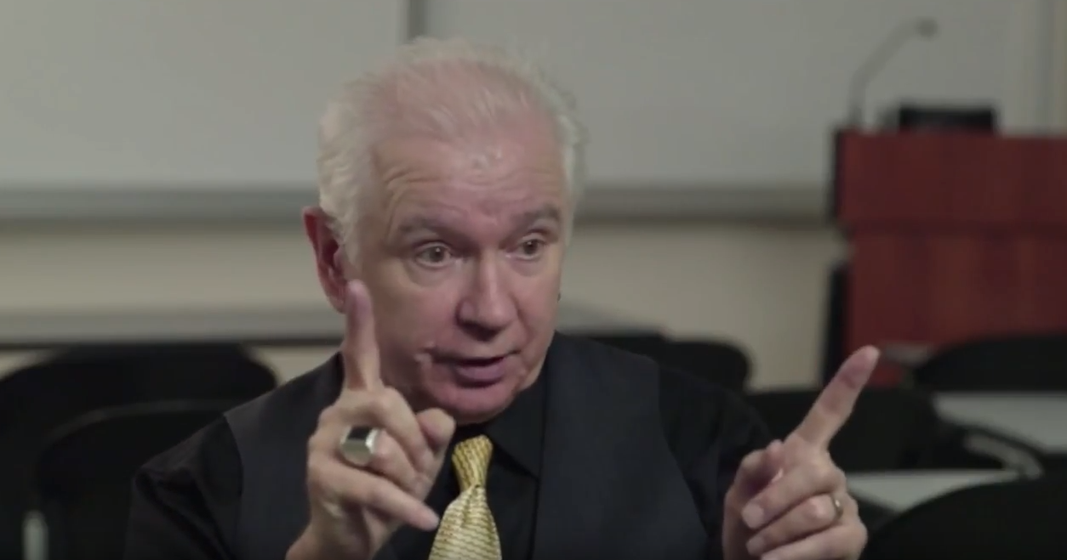
My climate setting speech
Call me Stephen – friendly atmosphere
I look forward to teaching – I learn so much from my students
My job – help you realize what you know
Questions – encouraged but I don’t know all the answers
Unanswered = Gifts for learning
No-one knows everything
Mistakes – richest moment in learning
Here’s examples of my errors
Unexpected Event – pool our wisdom

Slide 16
Students’ Meanings
You have a history of incompetence
Let’s split tuition
You’re lying – I don’t know as much as you
We can’t look to you for authoritative solutions
Let me get out of here & study with someone who knows what they’re doing!

Slide 17
Let’s see what’s on sli.do
Go to: sli.do
Enter code: 66026
Please post any comments, reactions, critiques & questions you have as we go through this session. Also, please use sli.do to post emerging themes, issues & questions that arise in your breakout group

Slide 18
Circle of Voices Protocol
(1) Begin with a period of 1-2 minutes silence where you think about your response to either or both of these questions:
What assumptions about being an effective teacher or leader have been challenged by any of the 4 lenses mentioned? (student feedback, colleagues’ perceptions, theory, personal experience)?
What problems, issues or contradictions arise as you try to incorporate critical reflection in your practice?
(2) Go alphabetically around the group and have each person give their response to the question(s) they’ve just been thinking about. Each person tries to keep their comments to a minute or so. No interruptions of each other please.
(3) Once everyone has spoken move into open conversation – anyone can speak at any time & there is no order of contribution. However, try to speak ONLY about what someone ELSE said in the opening round of comments.

