Slide 1
Preparing for Race Talk
Stephen Brookfield
http://www.stephenbrookfield.com/
sdbrookfield99@gmail.com
Current affiliations: Teachers College (Columbia University), Antioch University,
University of St. Thomas (Minneapolis-St. Paul)

Slide 2
How are we feeling?
Go to: sli.do
Enter Code: 18760
Vote for as many responses as you like

Slide 3
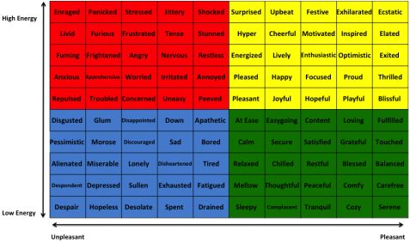
The Mood Meter (Yale)

Slide 4
Two Kinds of Preparation
Technical (Content) – reading, viewing, thinking, reflecting on nature of racism, white identity, white supremacy, anti-blackness etc.
Technical (Process) – how to model disclosure, choose good narratives, build trust, scaffold learning from simple to complex, use protocols
Emotional (EQ) – this is inherently emotional work in which people are laying bare their identities, experiences, convictions and feelings. It will sometimes be raw & contentious and people will become distressed, angry, and uncomfortable
Emotional (Mistakes) – this is inherently unpredictable work & you’ll constantly feel like you’ve screwed up, made mistakes, said or done the wrong thing, and mishandled situations
Two ways do do anti-racist work – IMPERFECTLY or NOT AT ALL!

Slide 5
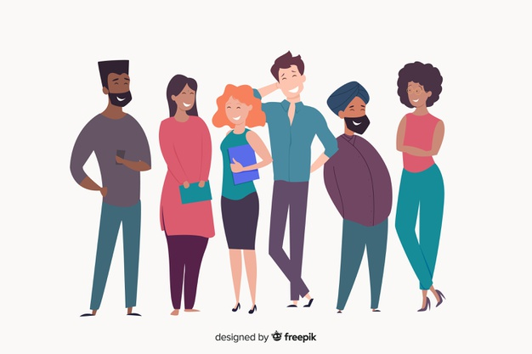
Adjusting Notions of Success The Kumbaya moment – not!

Slide 6
Preparing for a BRAVE (not just a Safe) Space
Where we expect to experience discomfort
Where we expect the expression of strong feelings and emotions
Where we don’t expect to reach consensus
Where we will leave a conversation knowing others think very differently from us
Where silence is viewed as a necessary dynamic of conversation – not as ‘awkward’
Where we understand that making ‘mistakes’, feeling unprepared & saying the ‘wrong’ thing are the nature of the activity
Where we focus on racism as a learned behavior, not as evidence of essential evil or a moral flaw
(Pawlowski, L. 2019. Creating a brave space classroom. In, S.D. Brookfield and Associates, Teaching race: Helping students unmask and challenge racism. San Francisco: Jossey-Bass)

Slide 7
Success is….being willing to continue talking & communicating ….with curiosity ….with silence ....with uncertainty ....with hesitation ..without resolution

Slide 8
Talking About Race – A Two Pronged Approach
For BIPOC: we need to unearth the psychic, emotional and physical costs of experiencing daily racism in an organization and what it’s like to negotiate white spaces set up to maintain white supremacist policies and practices. Some of this needs to be done in BIPOC only racial affinity and support groups
For whites: we need to examine how they have learned white supremacy - the belief that whites, because of their supposed higher intelligence should naturally be in positions of power and authority. Whites can explore what it means to have a white racial identity and how to develop a commitment to antiracism as part of that identity

Slide 9
What to Expect - An arithmetic level of understanding of the dynamics of pervasive, structural racism amongst many whites who have not thought much about racial identity & whiteness THIS IS A REASON FOR AFFINITY GROUPS
What to Expect - A calculus level of understanding amongst black, indigenous and people of color (BIPOC) who have negotiated the dynamics of structural racism & white supremacy all their lives
TIRED OF WITNESSING ‘WOKENESS’

Slide 10
“Good Whites” – like me (Stephen)
Believe that we don’t see race
Believe everyone is a human being & we should treat everyone the same (colorblind ideology)
Believe we focus on actions & individual character, not racial identity
Choose when to engage in race and anti-racism
Can monitor our own racism
Believe we have a pure, anti-racist soul
Believe we are free of white supremacist conditioning
View racism as something committed by less enlightened whites
Regard ourselves as allies of people of color
(Shannon Sullivan Good White People 2014)

Slide 11
Behaviors of “Good Whites”
When confronted with examples of their learned racism, good whites will vigorously deny any racist intent, claim they have been misunderstood, are acting innocently, & are being unfairly accused
Will become defensive & immediately seek to explain to people of color the “real” meaning of their behavior
Will resist “sitting with” the reality that they have learned racism & white supremacy throughout their lives & carry those viruses
Will accuse people of color of imagining things, seeing racism where it doesn’t exist, & denying the validity of whites’ experience
Will come to each other’s defense in multi-racial discussions
I know this because these are all of my learned behaviors
(Robin DiAngelo White Fragility 2018) (Shannon Sullivan Good White People 2014)

Slide 12
For Good Whites – Don’t Expect Approval
“I honestly have been having a hard time being in predominately white classes lately as people in this country realize, again, the issues that exist in America for Black people.
While she was giving her long spiel on her good work, I couldn't figure out where to place my feelings. I could see it from a mile away; I even prepped myself for it before the class.
I prepared for THIS, but I still wasn’t ready. Her actions were soooo predictable, well, to me. It was something I knew was bound to happen in a class placed right in the heart of the world grappling with whether or not Black lives matter. But still I felt completely uncomfortable, sick.
Now, I am not one to dim anyone's light, but all I felt like saying was, "oh, okay. That's cute. You want a cookie?"
I couldn't help but think, "this is not something new, why is it new to you? Why are you just now having these conversations?"
I do not know this woman and may never have a class with her again; however, I will always remember what she did and how it made me feel.”
Carmina Maye 2020 I Really Wanted this to Be a Poem. (Dept. of Art & Art Education, Teachers College)

Slide 13
Hard Truths – What I Know as a White Professional
I MUST call out racist behavior (including in myself) as soon as I see it. If I don’t I will have no credibility in the eyes of students and colleagues of color.
I MUST assume that for students and colleagues of color EVERYTHING is seen through the lens of race. For them, NOTHING is “race free”.
I MUST acknowledge my own racist behavior when it’s pointed out to me – not try to ‘explain’ it away, not protest my innocence: I must regard it as truth.
I MUST NEVER try to talk people of color “out of” their testimony of racism.
I MUST NEVER invoke “being respectful” or “seeing all sides of this” as a way of avoiding painful truths about my own socialization into, & learning of, racism.
I MUST NEVER claim to be an “ally” or anti-racist “friend”.
I MUST NEVER ask people of color to teach me about racism or to tell me what I should do – figuring out what whites should do is OUR responsibility .

Slide 14
So where do whites go from here?
Understand that calling out racism is the responsibility of whites
Don’t wait for people of color to say they’re uncomfortable with something – if you have any unease, name it
Work on naming racism as LEARNED behavior – not individual soul flaw
Strive to model anti-racist awareness in your own contributions
Understand white privilege/power as an unconscious phenomenon – not worrying about how your race makes things difficult for you
Don’t expect gratitude or thanks – you’re just doing the right thing
Don’t preach at, or disdain, those you regard as “less enlightened”
Don’t set up people to “confess” & then grant absolution
Don’t stay silent in multiracial discussions
Do assume you’ll say the “wrong” thing & leave feeling you messed up
Don’t declare yourself an ally to BIPOC

Slide 15
Steps to Prepare for Race Talk
Lose Your Desire/Expectation to Be Perfect
Send Round Introductory Reading/Viewing*
Take the Emotional Temperature –sli.do, Mood Meter
Begin By Modeling Self-Disclosure
Introduce the Concept of Brave Space
Use Conversational Protocols to Engage Everyone
(Circle of Voices, Circular Response, Bohmian)
Check In Regularly via Anonymous Channels
(sli.do, backchannelchat.com)
* Letter to White America (George Yancy) https://opinionator.blogs.nytimes.com/2015/12/24/dear-white-america/
* What it Means to be American (Color of Fear) https://www.youtube.com/watch?time_continue=3&v=2nmhAJYxFT4&feature=emb_logo
* Conversations on Race (New York Times) https://www.nytimes.com/interactive/projects/your-stories/conversations-on-race
* How Can We Win (Kimberly Latrice Jones) https://www.youtube.com/watch?v=ZkedkvNn5V0

Slide 16
General Resources
Ijeama Oluo – So You Want to Talk About Race (2019) https://www.youtube.com/watch?v=TnybJZRWipg
George Yancy - Look! A White (2012), What White Looks Like (2004), White Self-Criticality beyond Anti-Racism (2016) https://www.youtube.com/watch?v=fyZNAAr8czE
Derald Wing Sue – Race Talk & the Conspiracy of Silence (2016) https://www.youtube.com/watch?v=Nrw6Bf5weTM&t=53s
Shannon Sullivan – Good White People (2014) https://www.youtube.com/watch?v=UZo06BjmbbE
Robin DiAngelo – White Fragility (2018) https://www.youtube.com/watch?v=45ey4jgoxeU
Ibram X. Kendi – How to Be an Anti-Racist (2019) https://www.youtube.com/watch?v=TzuOlyyQlug
Glenn Singleton – Courageous Conversations About Race (2014) https://www.youtube.com/watch?v=IwaOBXzJ3hs
Tim Wise – White Like Me (2011) https://www.youtube.com/watch?v=N4fbr1LlxEk

Slide 17
Stephen’s Resources
Creating an Anti-Racist White Identity (Stylus – Forthcoming, 2021) w/Mary Hess
Teaching Race (Jossey-Bass, 2019)
Powerful Techniques for Teaching Adults (Jossey-Bass, 2013)
Teaching for Critical Thinking (Jossey-Bass 2012)
Radicalizing Learning (w/John Holst) (Jossey-Bass, 2011)
Handbook of Race and Adult Education (Jossey-Bass, 2010) w/ Vanessa Sheared, Juanita Johnson-Bailey, Scipio Colin Jr III, & Elizabeth Peterson
The Power of Critical Theory (Jossey-Bass, 2004)
www.stephenbrookfield.com
(Go to “Creating an Anti-Racist White Identity”, “Recent Writings” & “Workshop Materials” links)

