Slide 1
Teaching with Racial Identity in Mind Temple University 20th Annual Faculty Conference on Teaching Excellence
Stephen Brookfield
Distinguished Scholar, Antioch University
http://www.stephenbrookfield.com/

Slide 2
How to access this power point…
Go to my home page: http://www.stephenbrookfield.com/
Click on the “Resources” link (top left, next to ‘Home’
Scroll down to power points & pdf’s http://www.stephenbrookfield.com/powerpoints-pdfs
This power point is the 1st one listed –Teaching with Racial Identity in Mind
Feel free to steal anything from my home page – it’s open access for free download

Slide 3
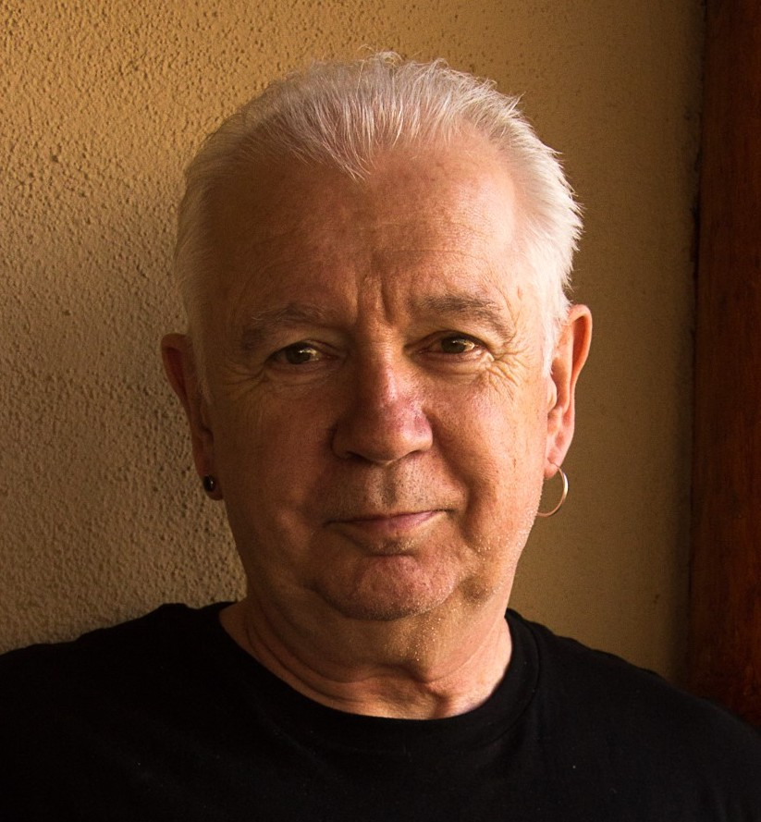
The (White) Elephant in the Room Another White man leading something on race – doesn’t this underscore the power of Whiteness?
The problem of race is the problem of unchallenged white supremacy – its idea & practice
At the heart of racism is the fact that many White folks such as Stephen Brookfield have not examined what it means to have a White racial identity
White students & colleagues need to see us typically & unremarkably center racial dynamics as a factor in teaching & leadership – “equity pause” in meetings
Diversity, equity & inclusion (DEI) work often involves cross-racial conversations & alliances – facilitated by a team of colleagues of different racial identities

Slide 4
I am from…*
the sound of seagulls crying over the north sea and merseybeat blasting at the Cavern club,
the smell of fish & chips, factory waste and coal burning fires,
the taste of grease, sour milk tea and dust at the back of my throat
the idea of community pride & the triumph of humor over pretentiousness
* Adapted from the poem Where I’m From by George Ella Lyon

Slide 5
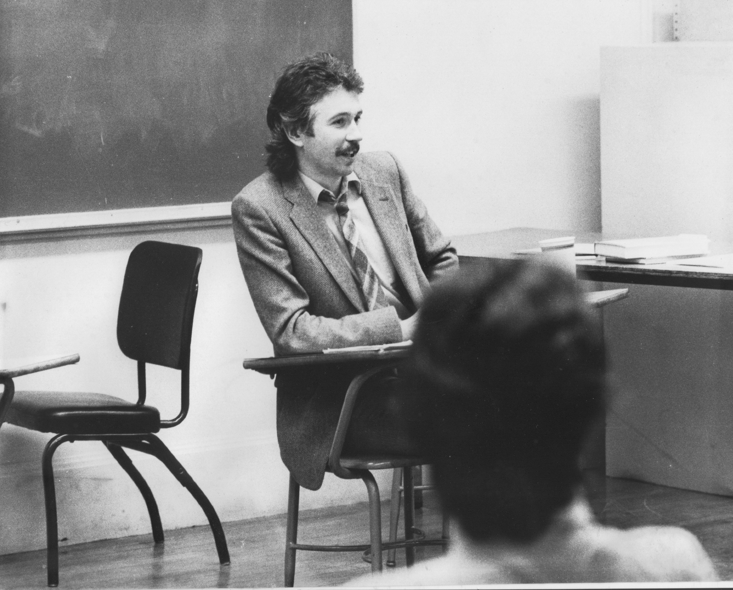
Situating Myself as a Teacher
History of academic mediocrity –failed high school leaving exams, university places cancelled, College of Technology, graduated in bottom half of my class, turned down for graduate study, failed my master’s degree exam
Broadening student-centered assessment measures Watching my doctoral supervisor – giving me ‘bad’ inconvenient news in a way that I knew was in my own best interests
Ethical use of teacher power
Relational underpinnings to critical thinking
Balancing credibility & authenticity

Slide 6
Situating Myself Racially Born into a White family in Liverpool, England grew up in the UK Did not speak to anyone who wasn’t White until I was 18 Spent over half my life regarding myself as a “Good White Person”* who has escaped racism with a color-blind perspective Will never lose the White supremacist conditioning I’ve received - blackness as dangerous & volatile Will always feel “unqualified” to talk about racism - & then remind myself I’m an expert on how white supremacy is learned Believe that Whites like me need to develop an antiracist identity** *Shannon Sullivan. 2014. Good White People (SUNY Press) ** Stephen Brookfield & Mary Hess. 2021. Becoming a White Antiracist (Stylus)

Slide 7
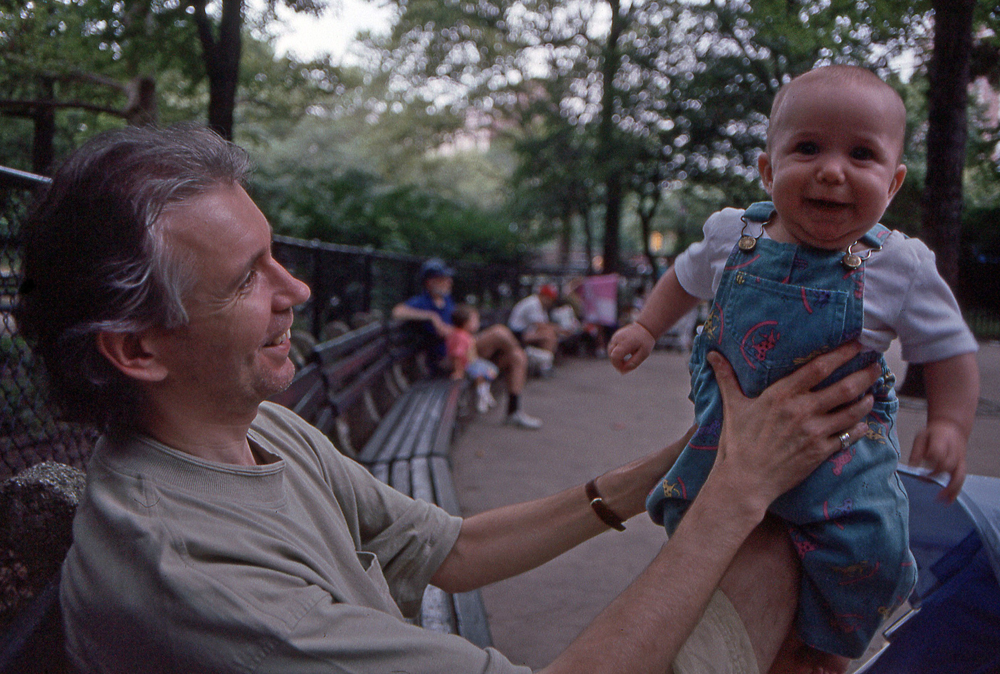
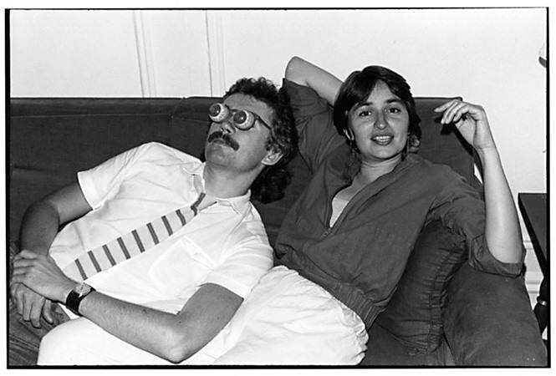
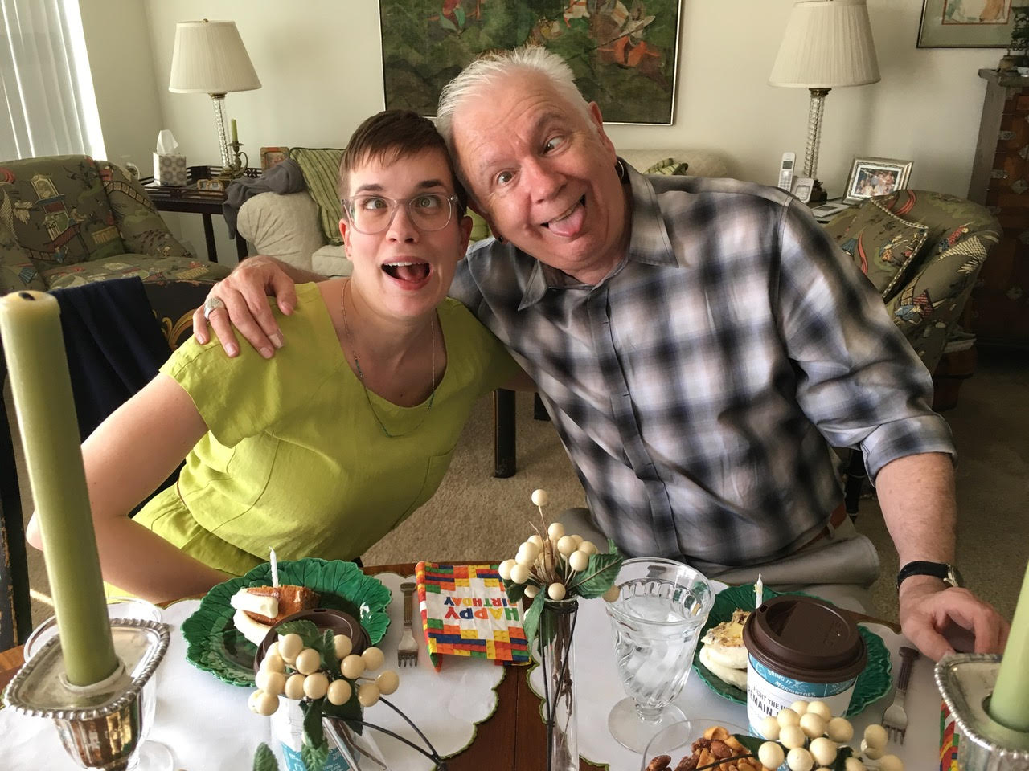
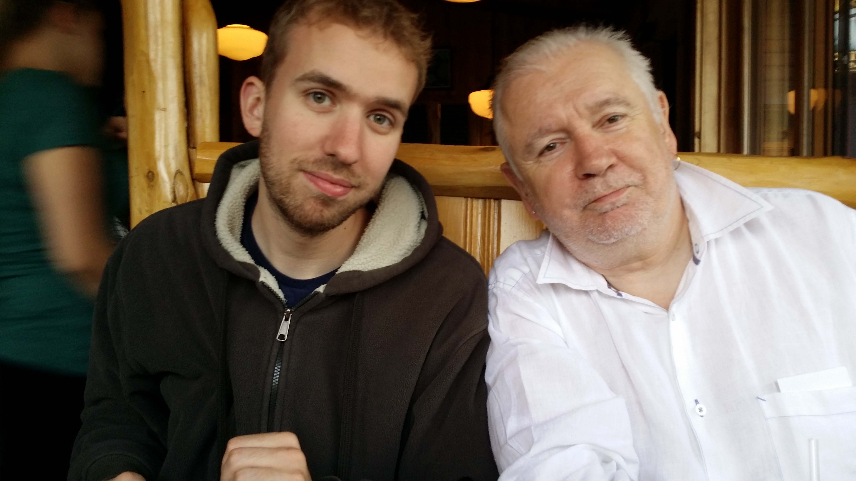
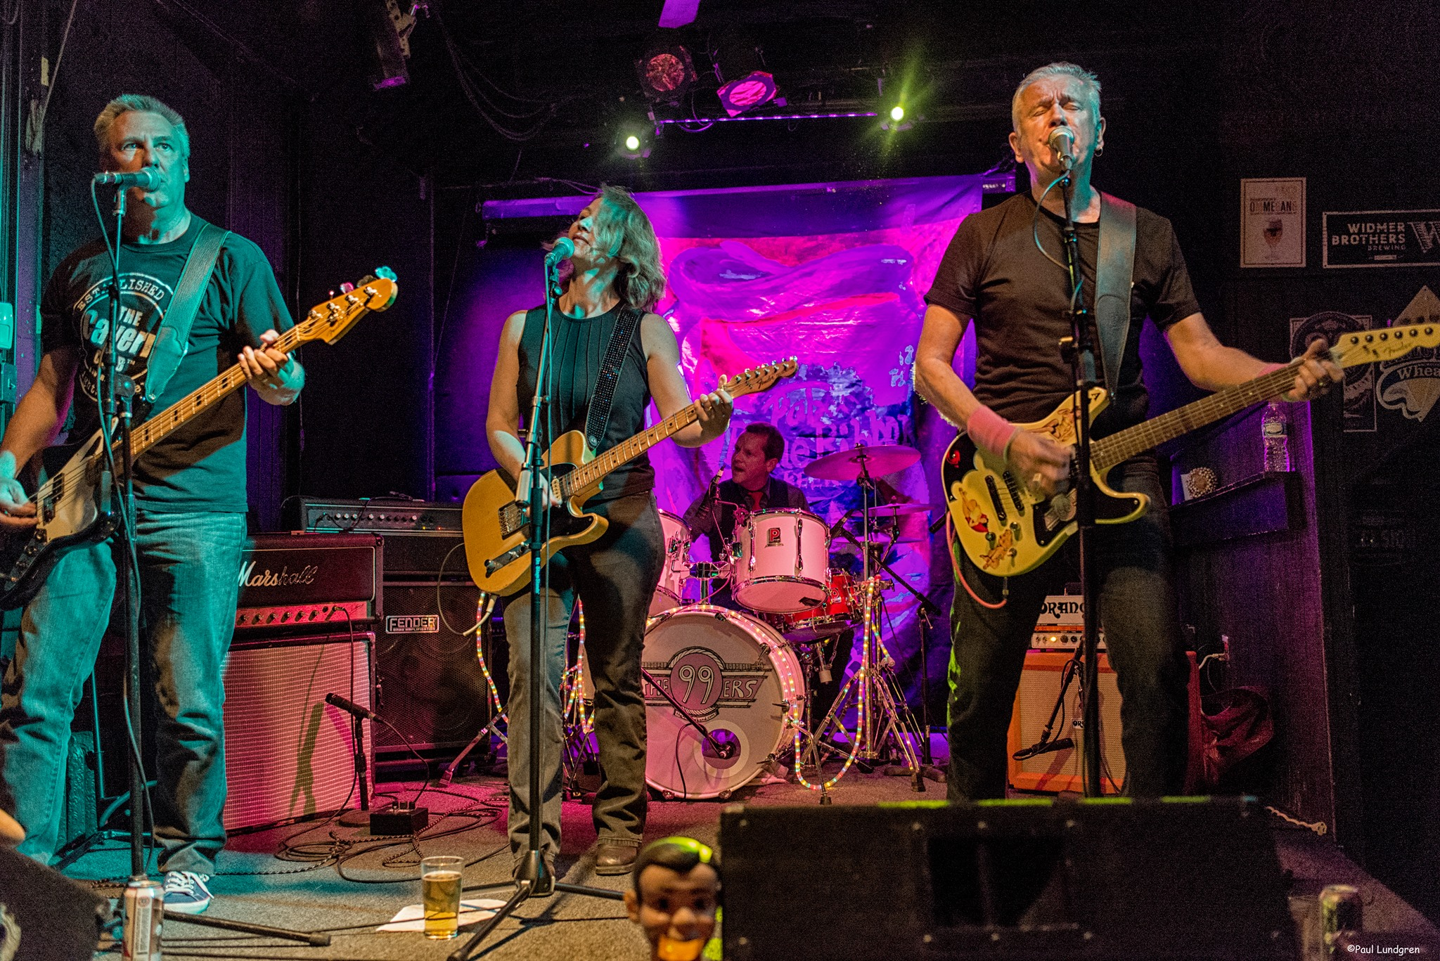
Who I am racially shapes how I experience the world – including my classroom As a White man Stephen has…. Often tried NOT to see color & treat everyone the same (color blindness) Had the freedom to choose when to focus on race Doesn’t have to worry about how his racial identity undercuts students’ perceptions of his pedagogic authority Is used to seeing people who look like him in leadership Will often be institutionally rewarded for raising issues of race & is not seen as playing the ‘race card’ Expects his expressions of ally-ship to be taken seriously Is regarded as ‘vulnerable’ and ‘brave’ when he admits to screwing up & owns his mistakes Is viewed with justifiable skepticism by many students of color when he talks about race Has withheld from commenting in multiracial groups & had that ‘malefic generosity’ seen as a lack of interest or commitment

Slide 8
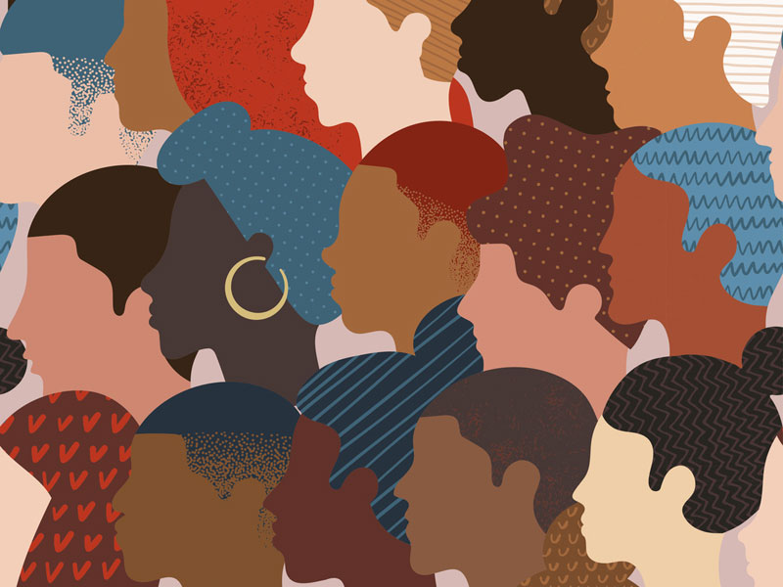
Why Spend So Much Time on ME in the first few slides? Isn’t this incredible self-indulgence?
Because students say that if a teacher models autobiographical disclosure around racial identity, & publicly engages with issues of race – it makes it MUCH easier for students to raise any concerns they have around racial dynamics in the classroom

Slide 9
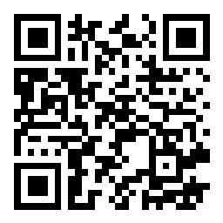
Let’s try a social media tool
Go to sli.do
Enter Code: Or use the QR code opposite (if you’re using a smart phone)
Give your response to the following question…. How have you heard or seen colleagues model an interest in racial dynamics within a class – or, how have you done this yourself?

Slide 10
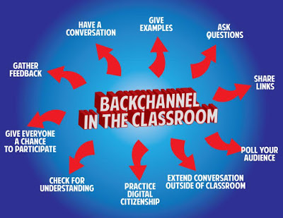
Pose a question at start of class to assess what knowledge, experience & preconceptions students bring
Pose quick questions during class to check for understanding, identify misconceptions
Invite students to raise questions or seek clarification anonymously
Interrupts the normal privileging of speech, extroverts, dominant language speakers – no one can dominate
Anonymity means students aren’t afraid to ask ‘dumb’ questions
As with all activities, open to sabotage
sli.do backchannelchat.com tweedback.de

Slide 11
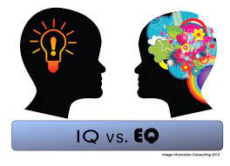
TWO KINDS OF PREPARATION FOR TEACHING & LEADING AROUND RACE
Technical (Content) – reading, viewing, thinking, reflecting on nature of racism, white identity, white supremacy, anti-blackness etc.
Technical (Process) – how to model disclosure, choose good narratives, build trust, scaffold learning from simple to complex, use protocols
Emotional (EQ) – this is inherently emotional work in which people are laying bare their identities, experiences, convictions and feelings. It will sometimes be raw & contentious and people will become distressed, angry, and uncomfortable
Emotional (Mistakes) – this is inherently unpredictable work & you’ll constantly feel like you’ve screwed up, made mistakes, said or done the wrong thing, and mishandled situations
Two ways to address race, racism, racial dynamics IMPERFECTLY or NOT AT ALL!

Slide 12
When Racial Dynamics Emerge &/or Need Addressing
Lose Your Desire/Expectation to address these ‘Perfectly’
Begin By Modeling Self-Disclosure Around Your Own Racial Identity/Struggles
When Possible Teach & Model Racial Cross-Talk as a TEAM
Consider Using Digital Narratives*
Take the Emotional Temperature –sli.do, Mood Meter
Introduce the Concept of Brave Space
Consider Introducing Racial Affinity Groups
Use Conversational Protocols to Engage Everyone
(Circle of Voices, Circular Response, Bohmian Dialogue)
Check In Regularly via Anonymous Channels
(sli.do, backchannelchat.com)
* Letter to White America (George Yancy) https://opinionator.blogs.nytimes.com/2015/12/24/dear-white-america/
* What it Means to be American (Color of Fear) https://www.youtube.com/watch?time_continue=3&v=2nmhAJYxFT4&feature=emb_logo
* Conversations on Race (New York Times) https://www.nytimes.com/interactive/projects/your-stories/conversations-on-race
* How Can We Win (Kimberly Latrice Jones) https://www.youtube.com/watch?v=ZkedkvNn5V0

Slide 13
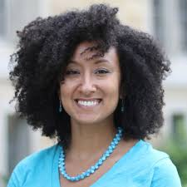
Team Teaching Allows You to…
Model how racial identity frames team decisions / process
Facilitate racial affinity groups
Show you sit with differences between you…
How you negotiate experiencing the classroom differently
Address racial imbalances in the teaching team’s operation
How you deal w/ micro aggressions, power asymmetries
How your racial & cultural identities frame your practice
Call & response, gumbo ya-ya, silence, group identity
Demonstrate how to engage in difficult conversations
….how to focus on behaviors not personhood
….how white supremacy is learned & internalized
….how racism is learned & NOT essential moral difference

Slide 14
WHITE AFFINITY GROUPS No need to prove oneself as a “good, woke White person” – or to declare allyship No opportunity to ask BIPOC to educate White people on race Lessens fear of saying the ‘wrong’ thing in front of BIPOC peers Removes temptation to ‘confess’ to racism & ask absolution from BIPOC
BIPOC AFFINITY GROUPS
No need to ‘take care’ of sensitivities of White egos
Chance to relax in real talk around experiences of racism
Can develop support networks & provide emotional sustenance
Share knowledge of negotiating the White power structure
No requests to ‘teach’ Whites about race

Slide 15
When Racial Dynamics Need to Be Addressed Consider the ‘Circle of Voices’ Protocol S. Brookfield & S. Preskill. 2015. The Discussion Book: 50 Great Ways to Get People Talking. Hoboken, NJ: Wiley.
CIRCLE OF VOICES
Equalizes the opportunity for conversation
Acknowledges silence as a necessary part of conversation
Allows every person to speak but in a way that’s as non-threatening as possible – important for subsequent participation
Designed to elicit a variety of perspectives & to stop the discussion being channeled prematurely into one analysis or viewpoint
Trains us in habits of careful listening
Encourages conversation to build on earlier contributions & go deeper

Slide 16
Circle of Voices What’s the best way you’ve taught – or seen a colleague teach – that takes accounts of different racial & cultural identities in the classroom?
Begin by reflecting silently & individually on the discussion question for 2 minutes. Use the time to make written or mental responses to the question
Form into groups of four
Go round the circle in alphabetical order (first names). Each person has up to 1 minute of uninterrupted air time to give their viewpoint on the topic. No interruptions are allowed
After everyone has spoken uninterruptedly, move into free discussion. No order of speaking.
However, follow the ground rule that every comment offered must somehow refer back to a comment made by someone else in the opening circle of voices.
This need NOT be agreement - it can be a disagreement, a question, an elaboration / extension, an illustration, request for information

Slide 17
Some Resources Authored by Stephen
Becoming a white antiracist: A practical guide for educators, leaders & activists. 2021. Sterling, VA: Stylus (w/Mary Hess)
Gospel Beautiful Podcast: https://www.buzzsprout.com/680528/8460030-stephen-brookfield-and-mary-hess-becoming-a-white-antiracist
Teaching race: Helping students unmask and challenge racism. Hoboken, NJ: Wiley Publishing
Becoming a critically reflective teacher. 2017 (2nd. Ed.). Hoboken, NJ: Wiley Publishing
Handbook of race and adult education. 2010. Hoboken, NJ: Wiley Publishing w/ Vanessa Sheared, Juanita Johnson-Bailey, Scipio Colin Jr III, & Elizabeth Peterson.
The discussion book: 50 great ways to get people talking. 2016. Hoboken, NJ: Wiley Publishing (w/Stephen Preskill)
www.stephenbrookfield.com
(Go to “Resources”, “Creating an Anti-Racist White Identity” and “Recent Writings” links)

Slide 18
General Resources
Ijeama Oluo. 2019. So you want to talk about race. New York: Seal Press. https://www.youtube.com/watch?v=TnybJZRWipg
George Yancy - Look! A White (2012), What White Looks Like (2004), White self-criticality beyond anti-racism (2016) https://www.youtube.com/watch?v=fyZNAAr8czE
N.M. Joseph, C. Haynes and F. Cobb (Eds.). 2016. Interrogating Whiteness & relinquishing power: White faculty’s commitment to racial consciousness in STEM classrooms. New York: Peter Lang,
Layla F. Saad. 2020. me and White supremacy: Combat racism, change the world, and become a good ancestor. Naperville, IL: Sourcebooks. https://www.youtube.com/watch?v=gMEXBFhA-NY
Derald Wing Sue 2016. Race talk & the conspiracy of silence. Hoboken, NJ: Wiley https://www.youtube.com/watch?v=Nrw6Bf5weTM&t=53s
Shannon Sullivan. 2014. Good White people. Albany: SUNY Press https://www.youtube.com/watch?v=UZo06BjmbbE
Robin DiAngelo. 2018. White fragility. Boston: Beacon Press https://www.youtube.com/watch?v=45ey4jgoxeU
Ibram X. Kendi. 2019. How to be an anti-racist. New York: One World Books https://www.youtube.com/watch?v=TzuOlyyQlug
Glenn Singleton. 2014 Courageous conversations about race. Thousand Oaks, CA: Corwin https://www.youtube.com/watch?v=IwaOBXzJ3hs
Tim Wise – White like me. 2011. Berkeley, CA: Counterpoint https://www.youtube.com/watch?v=N4fbr1LlxEk

