Slide 1
Teaching for Critical Thinking Through an Antiracist Lens College of Nursing & Health Sciences University of Vermont, May 23rd, 2023
Stephen Brookfield (he, him)
Distinguished Scholar, Antioch University
http://www.stephenbrookfield.com/

Slide 2
How to access this power point…
Go to my home page: http://www.stephenbrookfield.com/
Click on the “Resources” link (top left, next to ‘Home’
Scroll down to power points & pdf’s http://www.stephenbrookfield.com/powerpoints-pdfs
This power point is the 1st one listed – Teaching for Critical Thinking through an Antiracist Lens
Feel free to steal anything from my home page – it’s open access for free download

Slide 3
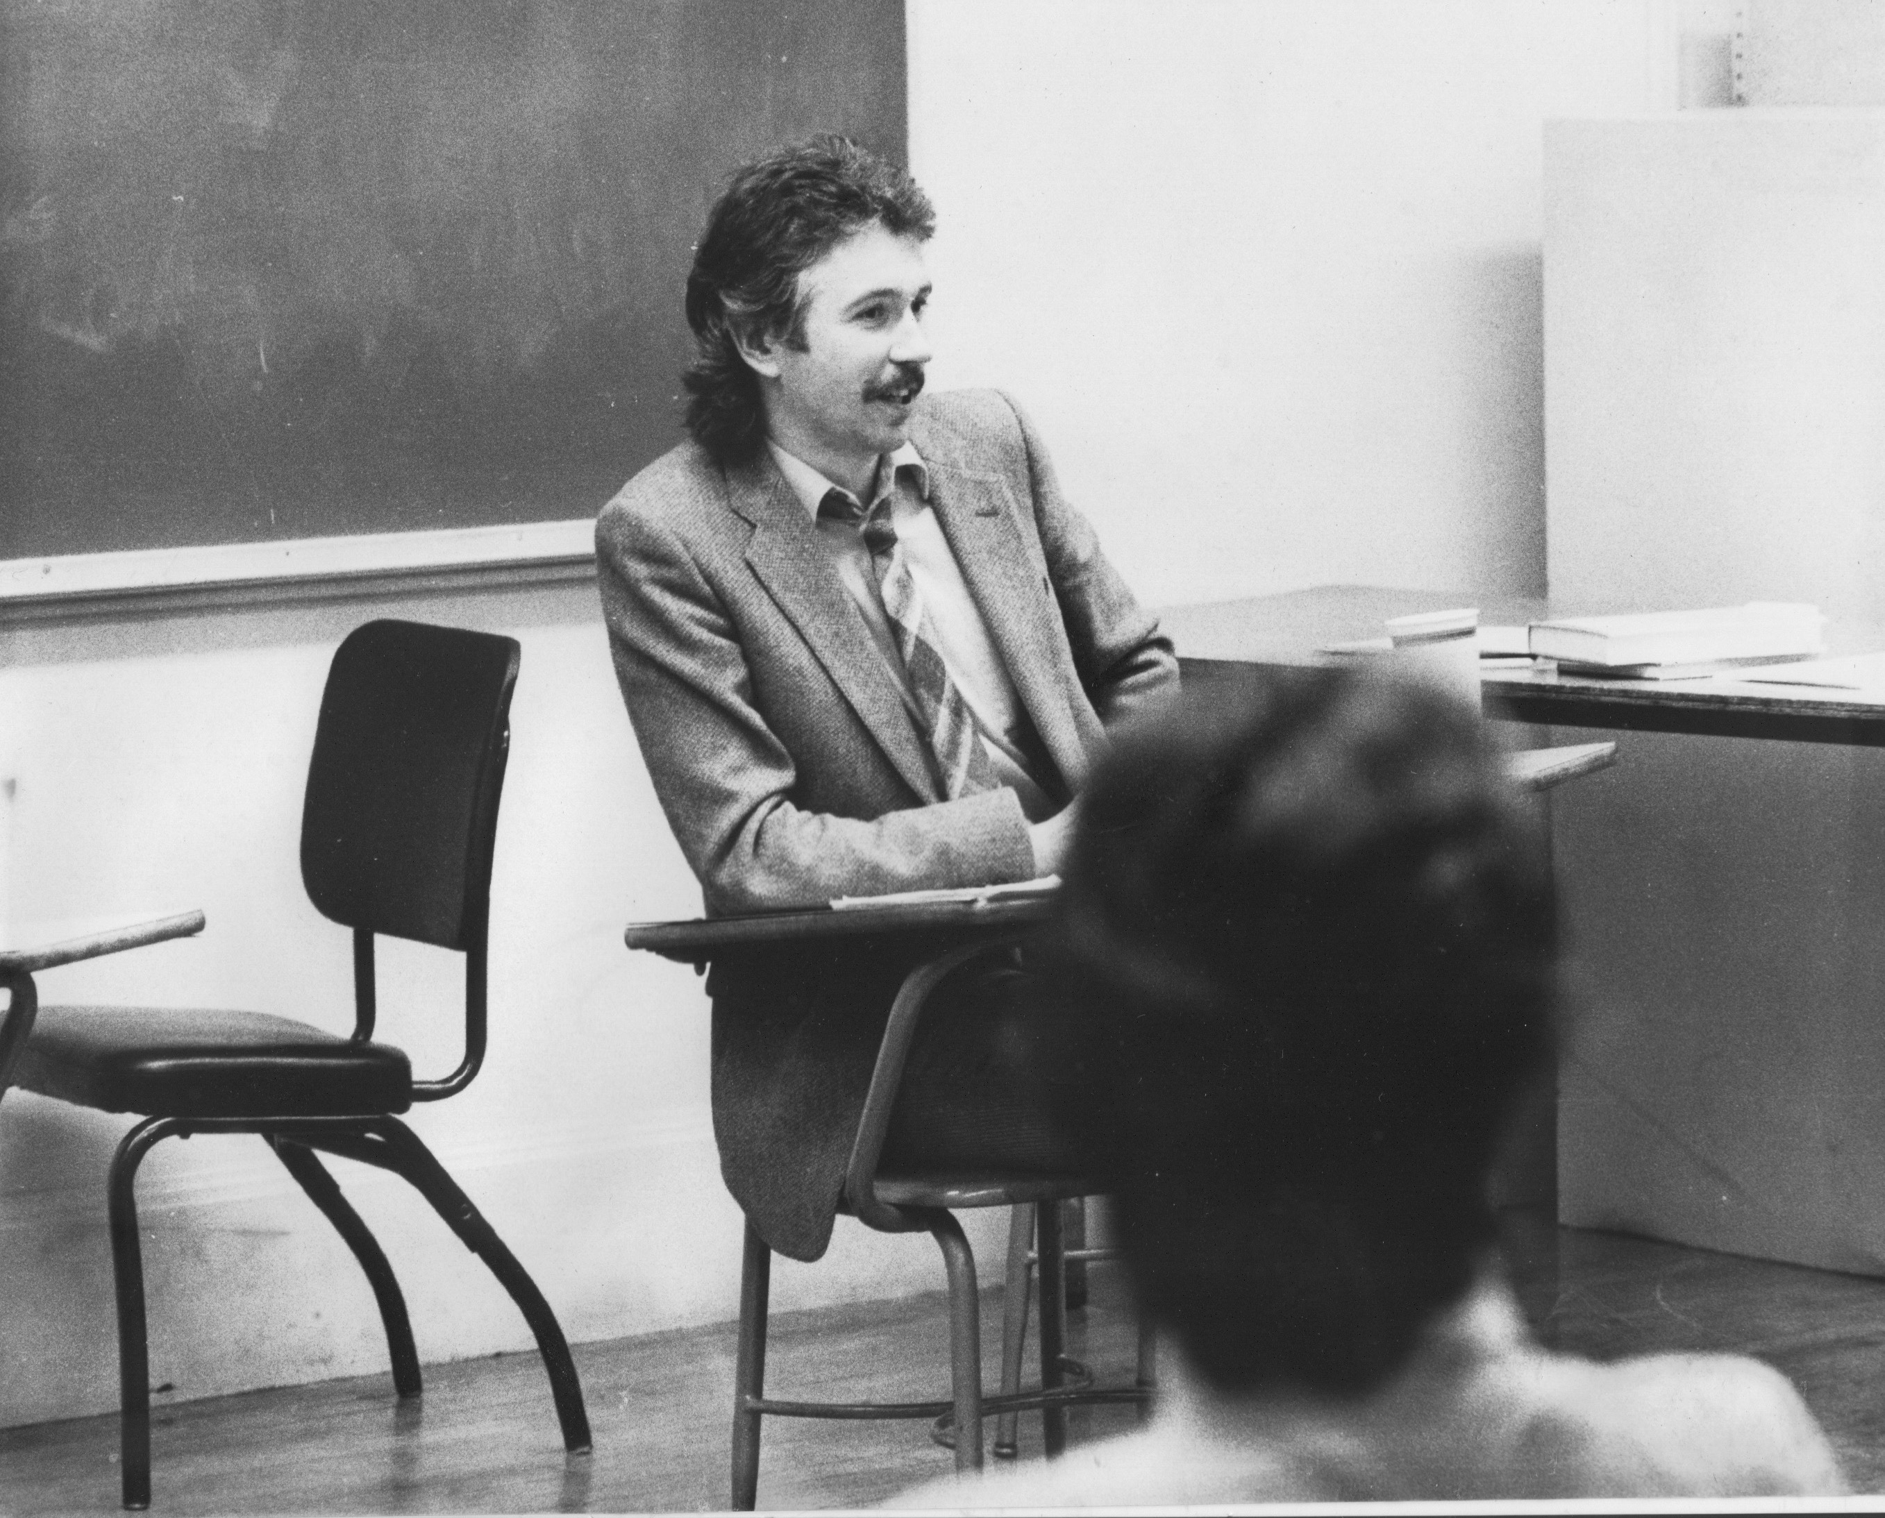
Who I am as a teacher is influenced by who I am as a learner…. History of academic mediocrity –failed high school leaving exams, university places cancelled, College of Technology, graduated in bottom half of my class, turned down for graduate study, failed my master’s degree exam – Broadening student-centered assessment measures
Watching my doctoral supervisor – giving me ‘bad’ inconvenient news in a way that I knew was in my own best interests Ethical use of teacher power Relational underpinnings to critical thinking An authoritative ally

Slide 4
Our Focus… How do people learn to think critically? And what approaches to teach it work best?
Our Focus…
What does it mean to think critically about race & racism in a PWI?
A Predominantly White Institution

Slide 5
Let’s Share “I Am From”
One of the ways to enter into any conversation around race is to encourage participants to be aware of the multitude of significant experiences and affiliations that people bring to an event.
The "I Am From" exercise is one way to do that.
Please share your ‘I Am From” words with each other in small groups
NO group reports needed – just listen to what’s shared

Slide 6
I am from…*
the sound of seagulls crying over the north sea and merseybeat blasting at the Cavern club,
the smell of fish & chips, factory waste and coal burning fires,
the taste of grease, sour milk tea and dust at the back of my throat
the idea of community pride & the triumph of humor over pretentiousness
* Adapted from the poem Where I’m From by George Ella Lyon

Slide 7
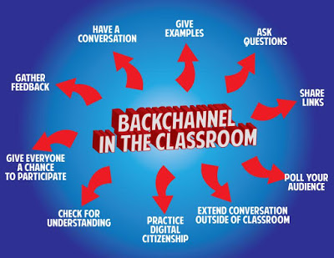
Sli.do backchannelchat.com tweedback.de
Interrupts the normal privileging of extroverts, dominant language speakers
Students can ask questions without fear
You can pose a question at start of class to assess knowledge, experience & preconceptions of students – but also to uncover ‘unsayables’: “what’s a recent example of structural racism you’ve witnessed, enacted or experienced at the school?”
You can pose quick questions during class to check for understanding, identify misconceptions
Students can critique your actions

Slide 8
Sli.do - A Social Media Backchannel Go to sli.do Enter Code: 2299999 Or use the QR code opposite Please provide an example of critical thinking that you've seen in yourself, a colleague, or a student Your response is ANONYMOUS

Slide 9
Hunting & Checking Assumptions TAKING INFORMED ACTIONS
Exploring Multiple Perspectives
TAKING INFORMED ACTIONS

Slide 10
An informed action is… Based on Assessed Evidence or Experience Has Its Assumptions Known & Checked Stands a Chance of Achieving Its Intended Consequence Has a Rationale that Can Be Clearly Explained to a 3rd Party
Someone who thinks critically can…
Identify The Assumptions Behind Their Thinking & Actions
Check Their Assumptions for Accuracy & Validity
View Their Ideas & Actions from Multiple Perspectives
Take Informed Action

Slide 11
What Students Say is Helpful
MODELING
Seeing It MODELED by instructors through team-teaching and through instructors practicing critical reflection & naming that process
PEER LEARNING
Using peers as sounding boards & mirrors to help reveal other ways of thinking & acting
SEQUENCED & SCAFFOLDED
Begin with simple case studies & scenarios
Move into analyzing increasingly complex questions
Over time bring the analysis to bear directly on our own reasoning and actions

Slide 12
A Personal Example – My Clinical Depression
Assumptions:
Clinical Depression is Caused by External Circumstances (So I shouldn’t be depressed)
The Way to Deal With Depression Is To Reason Through It (So I must tell myself to snap out of it)
Medications Are For Those Too Weak To Deal With The World
Rooted in Ideology: PATRIARCHY
(Men are to be entrusted with making decisions
by virtue of their superior rationality & logic)

Slide 13
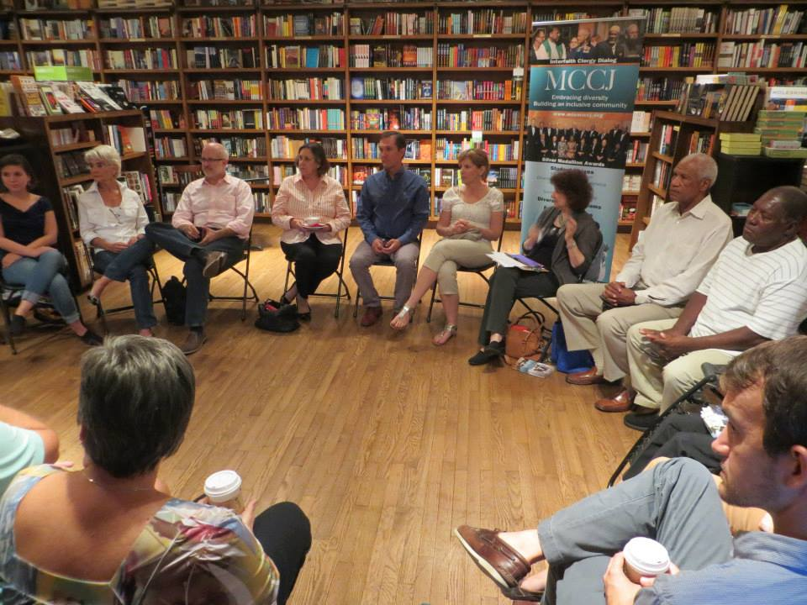
A Professional Example – The Circle

Slide 14
My assumptions
If I get to class early & arrange the chairs in a circle…
Students will feel their experience is respected & acknowledged when they walk in.
This will create a relaxed and congenial environment for learning
The distance between me as the teacher & them as the students will be reduced
They will see me as an ally for their learning – someone they can trust
Students will therefore be more likely to participate, contribute, ask questions etc.

Slide 15
The Circle Through Students’ Eyes
The circle is an arena of surveillance – everything I do will be seen, my mistakes will be noticed by everyone (peers & instructor)
The circle is alienating – if anything about me marks me out as different (how I look or sound) my discomfort is increased
The circle is coercion – you are coercing me into speech before you have earned the right to do that
The circle increases mistrust – I can’t sit back & judge your competence or authenticity, just let me process

Slide 16
NOW…
I still use the circle but explain…
It’s to keep sight lines clear – so students who wish to contribute or ask a question can do that easily
It’s so students don’t have to talk to the back of other people’s heads
I won’t assume that those who are quiet are less diligent or intelligent
I must self-disclose before expecting students to do the same

Slide 17
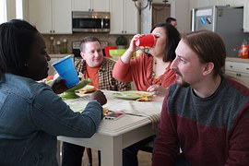
The Good White
I am a GOOD WHITE PERSON…
Assumptions…
I have escaped racist conditioning
I have self-knowledge
I can monitor my own racism
I know how my actions are perceived & experienced
I avoid committing racial micro-aggressions
I’m an ally to BIPOC colleagues & students
Racism is something committed by less-enlightened White friends & colleagues

Slide 18
I will never be free of the ideology of White supremacy I can try to unearth its presence personally & institutionally My responsibility is to raise racial questions & not to wait for colleagues of color to do this
Whether I am an ally or not is not my judgment to make
There is no ‘correct’ or ’right way’ to do this work – the only two options are to do it IMPERFECTLY or NOT AT ALL
I will never be fully antiracist

Slide 19
Classroom Equity Discussion Protocol
Here we will try a beginning protocol that is adaptable across both online & face-to-face contexts – the Circle of Voices
Please follow the protocol. We will work in groups of 5
The question….
When critical thinking is happening, what does it look, sound and feel like?

Slide 20
Circle of Voices S. Brookfield & S. Preskill. 2016. The discussion book: 50 great ways to get people talking. Hoboken, NJ: Wiley
Begin with a mandatory 2 minute silent period for people to think about their response to the question & make written or mental notes
Go alphabetically (using 1st names) around the group & have each person give their response to the question you’ve just thought about. Each person should keep their opening comments to no more than two minutes. No interruptions as each person speaks
Once everyone has spoken move into open conversation – anyone can speak at any time & there is no order of contribution. However, try to speak ONLY about what someone ELSE said in the opening round of comments
For example…
Ask questions about what someone said
Point out similarities & differences
Talk about new ideas you were exposed to
Give examples to illustrate what someone said
State the basis of your disagreement with a comment
Talk about how a comment led to a new understanding
Reference a question or issue someone’s comment raised for you

Slide 21
Found Poem – a Small Group Reporting Equity Protocol
Each group member nominates a phrase spoken by someone in the group during your discussion – these phrases will constitute a “found poem”
Make sure you choose a phrase from each person
When all the phrases are chosen…arrange them in whichever way makes sense to you
Have someone be ready to read your group’s “found poem” to everyone in the workshop

Slide 22
Two Kinds of Preparation for Teaching that Incorporates Race
Technical (Content) – reading, viewing, thinking, reflecting on nature of racism, white identity, white supremacy, anti-blackness etc.
Technical (Process) – how to model disclosure, choose good narratives, build trust, scaffold learning from simple to complex, use protocols
Emotional (EQ) – this is inherently emotional work in which people are laying bare their identities, experiences, convictions and feelings. It will sometimes be raw & contentious and people will become distressed, angry, and uncomfortable
Emotional (Mistakes) – this is inherently unpredictable work & you’ll constantly feel like you’ve screwed up, made mistakes, said or done the wrong thing, and mishandled situations
Two ways do do anti-racist work – IMPERFECTLY or NOT AT ALL!

Slide 23
An arithmetic level of understanding of the dynamics of pervasive, structural racism amongst many whites who have not thought much about racial identity & whiteness THIS IS A REASON FOR AFFINITY GROUPS
A calculus level of understanding amongst black, indigenous and people of color (BIPOC) who have negotiated the dynamics of structural racism & white supremacy all their lives
TIRED OF WITNESSING ‘WOKENESS’

Slide 24
CHALK TALK
What fears, uncertainties & doubts do you carry into this work?
Write your question in the center of the board
Bring everyone to stand by the board
For 5 minutes people stay silent – but write and draw their responses to the question on the board
As postings go up, participants draw lines connecting posts that seem similar or to deal with the same issue
When time is up, the whole group debriefs what’s been posted

Slide 25
Sequencing the Process of Teaching About Race
Lose Your Desire/Expectation to Be Perfect
Send Round Introductory Reading/Viewing*
Take the Emotional Temperature –sli.do, Mood Meter
Begin By Modeling Self-Disclosure
Introduce the Concept of Brave Space
Use Conversational Protocols to Engage Everyone
(Circle of Voices, Circular Response)
Check In Regularly via Anonymous Channels
(sli.do, backchannelchat.com)
* Letter to White America (George Yancy) https://opinionator.blogs.nytimes.com/2015/12/24/dear-white-america/
* What it Means to be American (Color of Fear) https://www.youtube.com/watch?time_continue=3&v=2nmhAJYxFT4&feature=emb_logo
* Conversations on Race (New York Times) https://www.nytimes.com/interactive/projects/your-stories/conversations-on-race
* How Can We Win (Kimberly Latrice Jones) https://www.youtube.com/watch?v=ZkedkvNn5V0

Slide 26
MODELING We take the lead in modeling disclosure about… How our racial identity frames our life How we struggle to understand & negotiate racism How we make sense of what’s happening in the wider world
BRAVE SPACES
It’s our responsibility to prepare students & colleagues for the ‘brave spaces’ they will enter as race is discussed…
The normality of strong emotions & feelings – anger, frustration, sadness, fatigue, desperation, confusion
The normality of silence as a necessary dynamic of making sense of starkly different realities
The discomfort that lies ahead & that is predictable & ‘normal’
The lack of closure

Slide 27
So where do White faculty go from here?
Understand that calling out racism is the responsibility of whites – don’t wait for BIPOC to be the first to raise these issues
Don’t wait for people of color to say they’re uncomfortable with something – if you have any unease, name it
Work on naming racism as LEARNED behavior – not as an individual soul flaw or inherent lack of humanity, empathy, compassion
Strive to model anti-racist awareness in your own contributions
Understand white privilege/power as an unconscious phenomenon – as not having to worry about how your race makes things difficult for you & anticipate how to negotiate barriers & survive emotionally

Slide 28
So where do White faculty go from here?
Don’t expect gratitude or thanks – you’re just doing the right thing
Don’t preach at, or disdain, those you regard as “less enlightened”
Don’t set up people to “confess” & then grant absolution
Don’t stay silent in multiracial discussions
Do assume you’ll say the “wrong” thing & leave feeling you messed up
Strive to act as allies – but watch out for making a big deal out of publicly declaring yourself an ally to BIPOC

Slide 29
Another Classroom Discussion Equity Protocol
Here we will try a different protocol that is slightly more complex.
It is also adaptable across both online & face-to-face contexts – Circular Response
Please follow the protocol. We will work in groups of 6.
The question (a sort of two-parter!)….
What dynamics around dealing with racial identity and/or racism do you find the most difficult to negotiate as an educator?

Slide 30
Circular Response S. Brookfield & S. Preskill. 2016. The discussion book: 50 great ways to get people talking. Hoboken, NJ: Wiley
Facilitator, leader or group members pose a question
Begin with 2 minutes silence - make some written or mental notes of your response
Someone gives an opening response for no more than 2 minutes – no interruptions
The next to speak is the person whose last name is next alphabetically to the 1st speaker. They take time to think about the opening comment & tries respond to it in some way. This can be an agreement or disagreement, extending the comment with an example, raising a question, explaining why it’s difficult to respond, applying the comment to a different context – no interruptions!
Person whose last name is alphabetically next to the 2nd speaker goes next. Again, they take time to think about the opening comment & try to respond to it – no interruptions
Process continues until everyone has spoken with each person striving to build on & respond to the previous speaker’s comment (with no interruptions)
Group then moves into open conversation with no ground rules.

Slide 31
Some Resources from Stephen
Becoming a white antiracist: A practical guide for educators, leaders & activists. 2021. Sterling, VA: Stylus (w/Mary Hess)
Teaching for Critical Thinking. 2012 Hoboken, NJ: Wiley Publishing
Gospel Beautiful Podcast: https://www.buzzsprout.com/680528/8460030-stephen-brookfield-and-mary-hess-becoming-a-white-antiracist
Teaching race: Helping students unmask and challenge racism. Hoboken, NJ: Wiley Publishing
Becoming a critically reflective teacher. 2017 (2nd. Ed.). Hoboken, NJ: Wiley Publishing
Handbook of race and adult education. 2010. Hoboken, NJ: Wiley Publishing w/ Vanessa Sheared, Juanita Johnson-Bailey, Scipio Colin Jr III, & Elizabeth Peterson.
The discussion book: 50 great ways to get people talking. 2016. Hoboken, NJ: Wiley Publishing (w/Stephen Preskill)
www.stephenbrookfield.com
(Go to “Resources”, “Creating an Anti-Racist White Identity” and “Recent Writings” links)

